Slide 1
This Week
High-performance computing (a.k.a. big compute)
Message Passing Interface (MPI)
Connecting GPUs together
Distributed model training
Generative adversarial networks

Slide 2
Different Computational Models: HPC vs. HTC
HPC = high-performance computing
Algorithm requires a lot of internode communication
Run on many low-latency interconnected (usually identical) nodes—expensive supercomputers
One program is run on many nodes (e.g., whole supercomputer)
We are interested in:
Speeding up computations to run very large number of iterations (e.g., timesteps of molecular simulation)
Calculating very large problem sizes (e.g., very large molecules)
Notes:
This lecture will cover a slightly different style of Computing than the rest of the course. First, let’s try to understand what the difference is. Of course, many of you have heard the term “High Performance Computing” before. While there is no strict definition of this term, community describes HPC as computations where many nodes are executing same program, but with different input data. This is quite common for Big Data as well. But in HPC the algorithm which this program implements requires a lot of inter-node communication. This is main difference from Hadoop workflow, for example. Because of this inter-node communication, HPC programs usually require low latency and high bandwidth – eg 10GbE or InfiniBand is preferred. In HPC we are interested in speeding up computations to run very large amount of iterations necessary for performing e.g. molecular simulation. Another focus area is pushing boundaries of problem sizes, e.g. simulating very large molecules, such as proteins. Such problems require really large and expensive supercomputers.
On the other hand, typical Big Data computations – let’s call them High Throughput Computing in this lecture – do not involve a lot of inter-node communication, therefore fast interconnect is not necessary. For example, Hadoop could pretty happy with cloud clusters and 1GbE interconnect. HTC is used to solve so called “embarrassingly parallel” problems, such as processing very large datasets or performing parameter scans, where one program is executed with different input parameters to find optimal ones by brute force search.

Slide 3
Different Computational Models: HPC vs. HTC
HTC = high-throughput computing
Usually used to solve embarrassingly parallel problems
Nodes rarely need to communicate, so interconnect is not important
Each node runs separate program copy (job) but with different input data and for long period of time
We are interested in:
Processing very large datasets
Parameter scans where the same program is run with varying inputs to find optimal parameters
Notes:
This lecture will cover a slightly different style of Computing than the rest of the course. First, let’s try to understand what the difference is. Of course, many of you have heard the term “High Performance Computing” before. While there is no strict definition of this term, community describes HPC as computations where many nodes are executing same program, but with different input data. This is quite common for Big Data as well. But in HPC the algorithm which this program implements requires a lot of inter-node communication. This is main difference from Hadoop workflow, for example. Because of this inter-node communication, HPC programs usually require low latency and high bandwidth – eg 10GbE or InfiniBand is preferred. In HPC we are interested in speeding up computations to run very large amount of iterations necessary for performing e.g. molecular simulation. Another focus area is pushing boundaries of problem sizes, e.g. simulating very large molecules, such as proteins. Such problems require really large and expensive supercomputers.
On the other hand, typical Big Data computations – let’s call them High Throughput Computing in this lecture – do not involve a lot of inter-node communication, therefore fast interconnect is not necessary. For example, Hadoop could pretty happy with cloud clusters and 1GbE interconnect. HTC is used to solve so called “embarrassingly parallel” problems, such as processing very large datasets or performing parameter scans, where one program is executed with different input parameters to find optimal ones by brute force search.

Slide 4
Typical Problems: HPC vs. HTC
Typical HPC problems: simulation of physical/chemical/biological processes
Molecular dynamics simulation
Computational fluid dynamics
Oil reservoir modeling
Weather modeling
And so on
“Continuous” processes
Methods: mainly partial differential equations
Notes:
In general, typical workloads for HPC come from simulation of physical, chemical or biological process, such as molecular dynamics simulation, computational fluid dynamics, oil reservoir or weather modeling. These are ‘continuous’ processes which are described by partial differential equations. Parallel implementation of these methods require a lot of interprocess communication, similarly to matrix-matrix multiplication.
On the other side, typical HTC workloads come from large-scale data processing, such as genomics, clustering, text processing, data mining, etc. These processes are ‘discrete’ and problems usually solved by using methods of machine learning, such as neural networks, regression, Bayesian networks, graphs etc.

Slide 5
Typical Problems: HPC vs. HTC
Typical HTC problems
Large-scale data processing
Computational genomics
Document clustering
Inverted index construction for Web search engines
Parameter scans
Monte Carlo statistics
Machine learning
Data mining
And so on
“Discrete” processes
All sorts of methods: Bayesian networks, neural networks, decision trees, graphs, and so on
Notes:
In general, typical workloads for HPC come from simulation of physical, chemical or biological process, such as molecular dynamics simulation, computational fluid dynamics, oil reservoir or weather modeling. These are ‘continuous’ processes which are described by partial differential equations. Parallel implementation of these methods require a lot of interprocess communication, similarly to matrix-matrix multiplication.
On the other side, typical HTC workloads come from large-scale data processing, such as genomics, clustering, text processing, data mining, etc. These processes are ‘discrete’ and problems usually solved by using methods of machine learning, such as neural networks, regression, Bayesian networks, graphs etc.

Slide 6
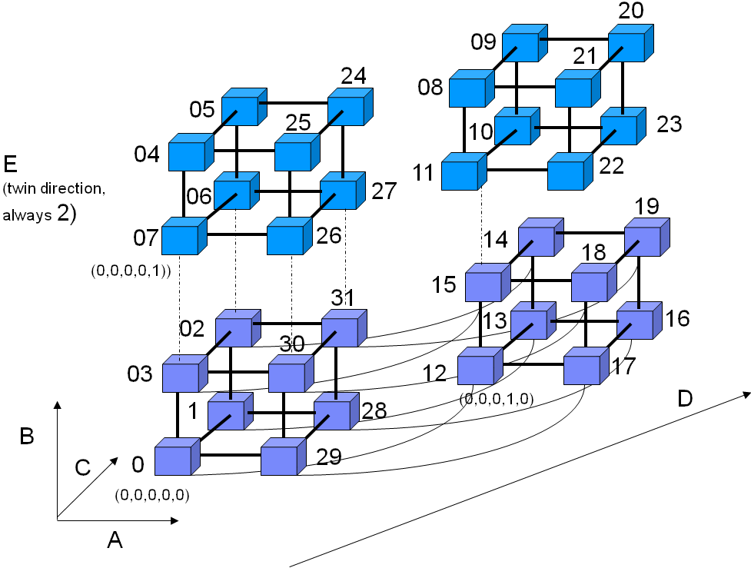
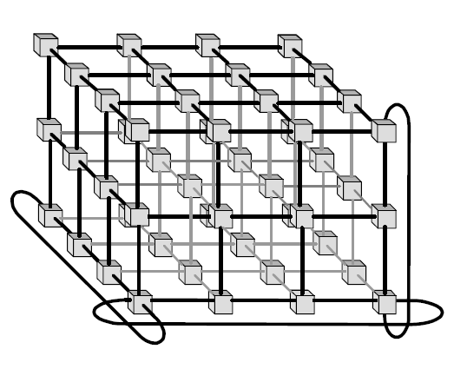
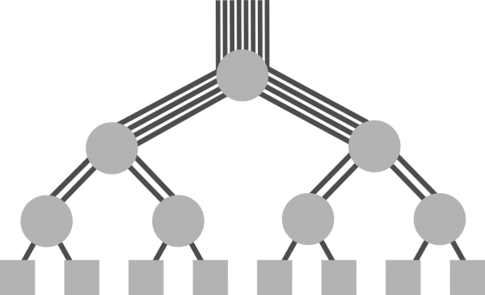
Architecture of Supercomputers
Define supercomputer as:
Large collection of mostly homogenous nodes
Connected by special interconnect—high bandwidth and low latency
Organized in a certain topology, typically one of two:
Multi-dimensional torus
Fat tree
3D torus
5D torus
Fat tree
Notes:
So, for tackling HPC problems we need a supercomputer – a large collection of mostly homogenous nodes (imagine an extremely large cluster) equipped with very fast and low-latency interconnect.
Topology, in which nodes are connected, is very important for ensuring high bandwidth on large number of nodes. In modern supercomputers two types of topologies dominate: the multidimensional torus and the fat tree.
In a multidimensional torus, e.g. 3D, nodes are connected into mesh of certain dimensions and endings are looped to form torus in each dimension. In this topology a node can only send messages to its neighbors. In case if a node needs to send to or receive data from other node, the system will find the optimal path between nodes and pass the message through all nodes in-between. Higher dimensional tori (e.g. 5D) will have shorter average paths than lower-dimensional. For example, the latest version of the Blue Gene/Q supercomputer uses a 5-dimensional torus topology, though one of the dimensions is always 2 and not shown on the picture above.
Another popular topology used in supercomputers is the fat tree. In a fat tree all nodes are connected to all others through a series of very large and high-performance switches organized into a tree with several layers. Nodes can send messages to other nodes, and these messages will traverse the tree through switches. For example, a message may have to travel to the root switch in case when the receiving node is connected to the totally different branch of the tree, but the length of any path is 2 * number of levels in tree max

Slide 7
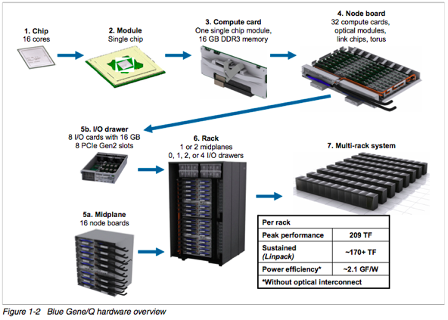
2014 Example: Blue Gene/Q
Notes:
This slide describes how the IBM Blue Gene/Q supercomputer is constructed. In Blue Gene/Q a node is made of a 16-core POWER A2 chip working at a modest 1.6GHz. The Chip is embedded into a so-called system-on-a-chip module together with all necessary network and memory connections. This system on a chip is then equipped with 16 GB DDR3 memory (1GB per core) to form a compute card. Then the 32 compute cards are placed on a node board together with optical network wiring. Note that the node board does not have any connection to disks yet. 16 Node cards form a Midplane, two midplanes create a rack with the total 1024 chips (16384 cores). Each Midplane also has a special IO drawer with network connections to disk storage, so nodes on a midplane could send data to storage through IO board. IO request routing is performed by the operating system of the Blue Gene. Finally, racks could be connected together and produce multi-rack system. the Largest BG/Q installation to date is called Sequoia (LLNL) and consists of 96 racks.

Slide 8
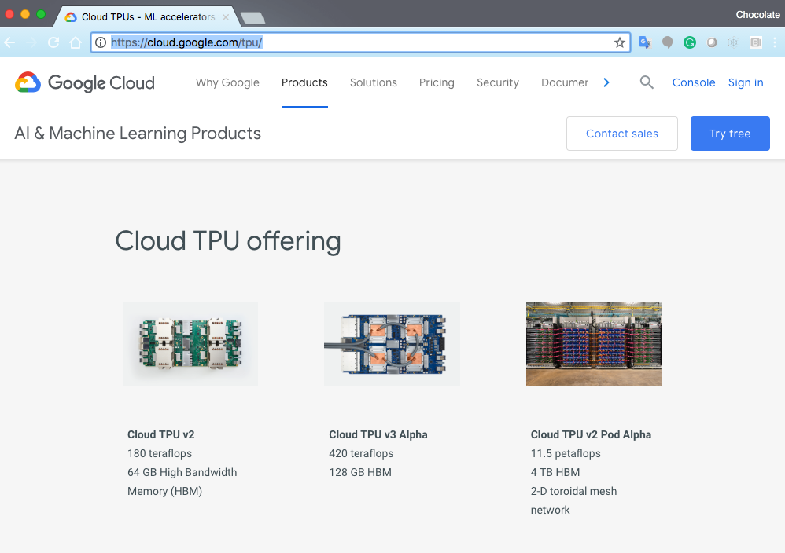
2018: Google TPUs

Slide 9
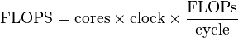
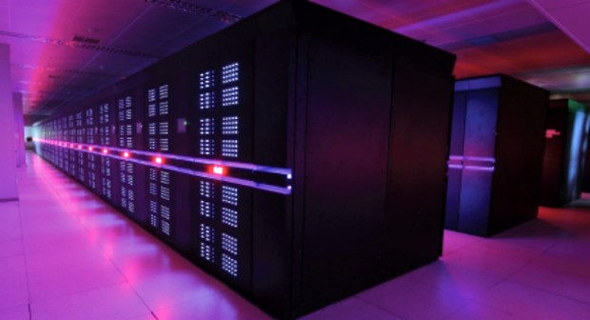
How to Compare Supercomputers
FLOPS = floating point operations per second
TOP500
Ranking of 500 most powerful supercomputers
Updated twice a year by a committee
Based on LINPACK benchmark
As of November 2013, the fastest system in the world is:
Chinese Tianhe-2
Peak (theoretical) FLOPS rate = 54.9024 PetaFLOPS
Sustained (achieved on LINPACK) rate = 33.8627 PetaFLOPS
Notes:
Everyone likes benchmarking so as to compare their computer to others. Supercomputers are not an exception. Supercomputers can be compared by using one of very important metrics for mathematical problems – number of floating point operations per second which the supercomputer can produce – FLOPS. The Peak FLOPs value can be calculated on paper from known information about processors used in supercomputer by using a formula on this slide. However, in real applications it is never possible to achieve peak FLOPS value because of pipeline stalls due to complex memory access patterns, waiting for network data from other processors, etc.
In 1993 Jack Dongarra suggested to measure how fast a supercomputer can solve a dense system of n by n linear equations Ax=b which is a common task in HPC workloads. This benchmark is called LINPACK. The Result of a LINPACK benchmark is called sustained performance and it is also measured in FLOPS.
Project TOP500 maintains a list of most powerful supercomputers according to this benchmark since 1993.
The Current TOP500 champion is a Chinese system called Tianhe-2. Its peak performance is almost 55 PetaFLOPS (10^15), and a sustained (achieved on LINPACK) equals to 33.87 PetaFLOPS. Note that, despite significant efforts of Tianhe team, it was impossible to get more than ~60% percent of peak performance. This is a common problem in building supercomputers – it is very difficult to fully utilize potential of the supercomputer. We have to design algorithms specifically to improve this utilization potential.
Note that supercomputers differ in how difficult it is to acquire full potential. For example, Blue Gene architecture is more beneficial in terms of sustained/peak performance ratio, and typical ratio in Blue Genes is as high as 85%.

Slide 10
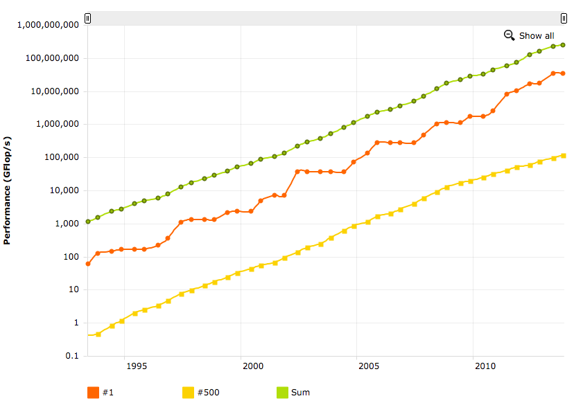
Supercomputers: 2014
6–8 years
iPhone 5
Laptop
10–12 years
In 6–8 years number 1 becomes number 500
In 10–12 years number 500 supercomputer becomes laptop
Source: www.top500.org
Notes:
This chart displays how #1 on TOP500 list has evolved over time. Red line in the middle is sustained – that is measured on LINPACK benchmark -- performance of #1. Green line above is cumulative performance of all 500 supercomputers in the list. Yellow line below is #500. Notice the trend – lines are almost perfect log linear. This trend it allows us to project future performance of supercomputers. Notice also that #1 becomes #500 in 6-8 years – this is the lifespan of a supercomputer.
Notice also that an ordinary laptop has the level of performance which 10-12 years ago was enough to be #500.
Think for a moment: we have so much processing power today literally at our finger tips. Today’s iPhone 5 would have been in 1993 the fastest computer in the world.

Slide 11
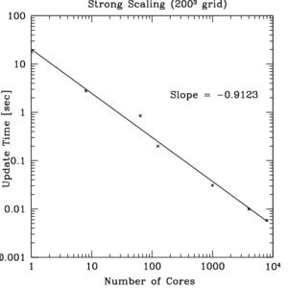
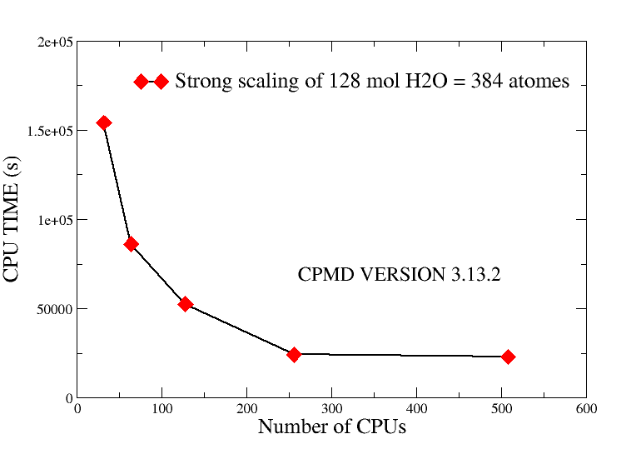
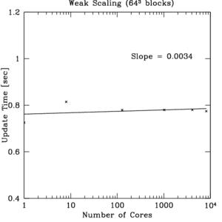
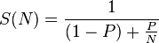
Scalability
Strong scaling
Fix total problem size
Add processors
Observe solution time
Weak scaling
Fix problem size per processor
Add processors
Observe solution time
Amdahl’s law
If P is the proportion of a program that can be made parallel (i.e., benefit from parallelization) and (1 − P) is the proportion that cannot be parallelized (remains serial), then the maximum speedup that can be achieved by using N processors is:
Perfect strong scaling
Real-life strong scaling
Perfect weak scaling
Notes:
So, a supercomputer has many compute nodes. It would be great if all our programs could benefit from using multiple processors. In previous slides we called problems, which always benefit from increasing number of processors, embarrassingly parallel. But what happens with programs that are not embarrassingly parallel?
We can introduce the concept of scaling - an important characteristic of a parallel program in the HPC domain. There are two types of scaling: strong and weak, and all algorithms differ in their scaling properties.
To measure how program scales in the strong sense we fix the total problem type and size (e.g. fix the model of a molecular system), add processors and observe how solution time decreases. It would be great if solution time would decrease in 10 times if we use 10 times more processors – this would be called a perfect strong scaling. However, this could only be achieved on embarrassingly parallel problems.
In real life network communication starts to dominate as we increase processors, therefore scaling starts to degrade – see ‘the real life strong scaling’ diagram. At some point for certain problem size and algorithm it does not make sense to add processors as the problem does not scale anymore. So one of the most important problems in HPC today is the design of ultra-scalable algorithms to be able to utilize modern behemoth supercomputers with millions of nodes.
Weak scaling is another interesting metric. Here, we fix problem size _per processor_, add processors and, again, observe solution time. In the ideal case solution time should remain the same, but in real life that’s rarely the case.
Finally, let’s learn one important law which allows to better understand maximum achievable strong scaling.
Imagine that a serial program spends P percent of time in parts that can be parallelized (e.g. calculations), and remaining (1-P) percent cannot be parallelized (e.g. reading input data). Then, the maximum speedup that can be achieved by using N processors is given by the formula on the slide. This means that even if we infinitely speedup (parallelize and use infinite number of processors) half of the program, we will never achieve more than 2x total speedup.

Slide 12
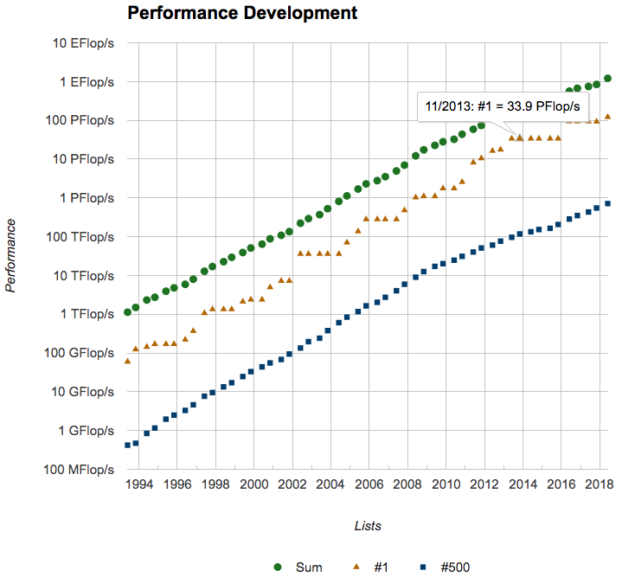
Supercomputers: 2018

Slide 13
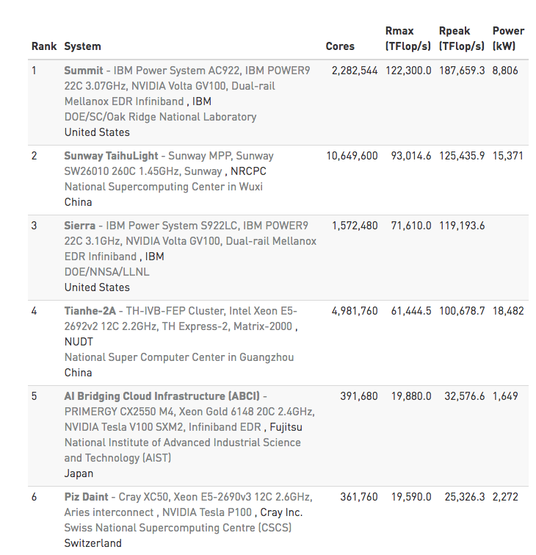
June 2018 Top List
GPUs

Slide 14
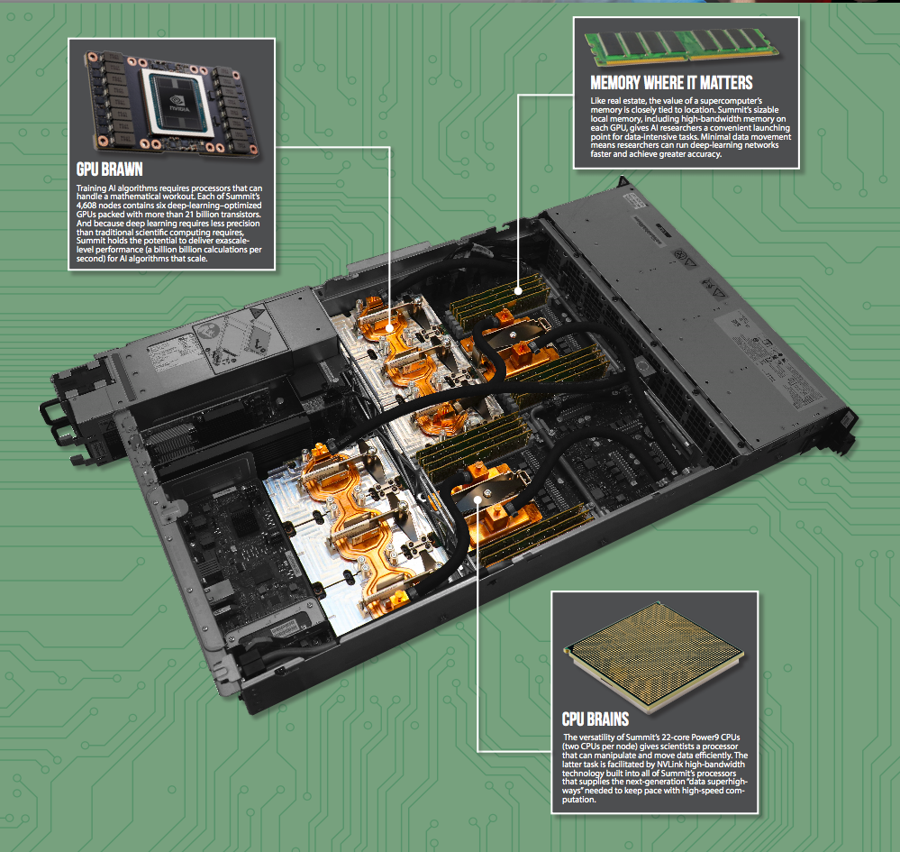
Summit

Slide 15
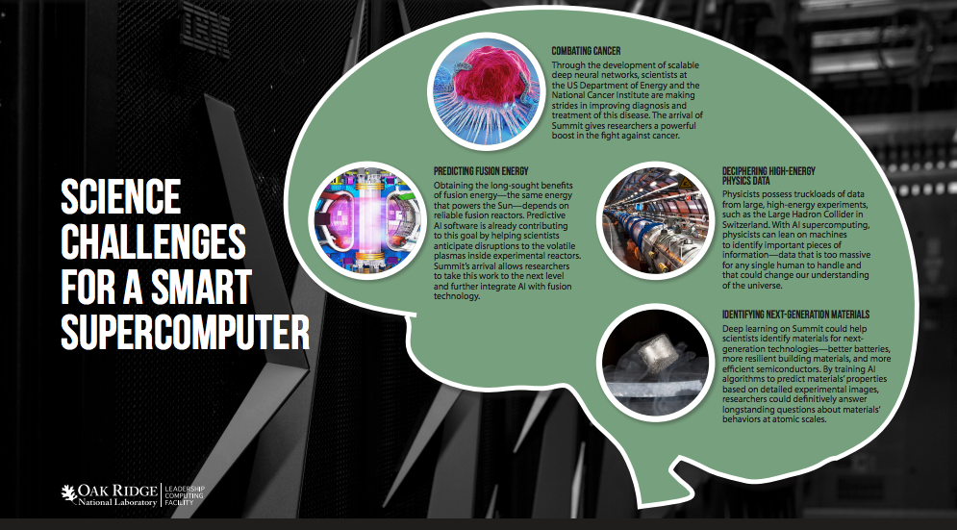
Summit Use Cases

Slide 16
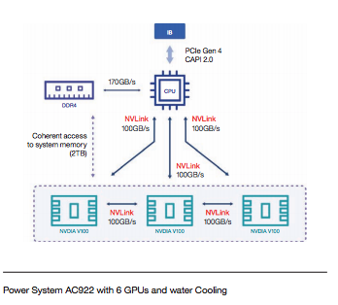
One Newell Node

Slide 17
MPI: Message Passing Interface
Standardized portable vendor-independent library for message-passing programming
Data is moved from the address space of one process to that of another process through cooperative operations on each process
Multiple implementations exist (both open-source and vendor-provided)
Every supercomputer has MPI installed
Support many languages
C/C++ and Fortran are always available on supercomputers
There are bindings for some other languages, but adoption is much less in real HPC
Notes:
MPI is a standardized portable vendor-independent library for message passing programming. Every supercomputer has some version of a MPI library installed.
MPI programs can be written in many languages, but only Fortran and C/C++ are widely used in real supercomputers because these relatively low-level languages allow to achieve highest levels of performance.
In MPI the same binary program is run on a collection of nodes. Nodes explicitly pass messages to other nodes. Operations can be point-to-point, when single node sends to other single node, or collective, when single node sends or receives messages from a group of other nodes. Also, there is a way to synchronize group of processes by using a barrier: all processes in a group will wait until all others will reach this barrier.
Every node belongs to one or more groups of processors called ‘communicators’ and has a unique ‘rank’ within each group. These are very important parameters which allows processors to coordinate.
Following slides will give a high level overview of MPI. In order to implement anything practical we highly recommend to go through the reading list at the end of these slides and learn more about MPI.

Slide 18
MPI: Message Passing Interface
Main concepts
Point-to-point operations: one process sends message to another
Communicator: group of processes
Collective communication: one process send message to all processes in a communicator
Synchronization between processes: process waits on a barrier until all processes of a group also reach this barrier
All distributed DL systems currently use some version of MPI
Notes:
MPI is a standardized portable vendor-independent library for message passing programming. Every supercomputer has some version of a MPI library installed.
MPI programs can be written in many languages, but only Fortran and C/C++ are widely used in real supercomputers because these relatively low-level languages allow to achieve highest levels of performance.
In MPI the same binary program is run on a collection of nodes. Nodes explicitly pass messages to other nodes. Operations can be point-to-point, when single node sends to other single node, or collective, when single node sends or receives messages from a group of other nodes. Also, there is a way to synchronize group of processes by using a barrier: all processes in a group will wait until all others will reach this barrier.
Every node belongs to one or more groups of processors called ‘communicators’ and has a unique ‘rank’ within each group. These are very important parameters which allows processors to coordinate.
Following slides will give a high level overview of MPI. In order to implement anything practical we highly recommend to go through the reading list at the end of these slides and learn more about MPI.

Slide 19
MPI Communicators and Ranks
Communicator is an object in MPI that defines a group of processes
Most MPI routines require you to specify the communicator
The process may belong to multiple communicators at the same time
Communicators are created by the programmer manually, except MPI_COMM_WORLD
MPI_COMM_WORLD is provided by the MPI runtime when program starts
Contains all available MPI processes
Notes:
One of the most important concepts in MPI is the communicator. A Communicator is an object which defines a group of processes. Remember that the same program is run on several processes. This is different from, for example, Hadoop, where each process gets a separate a task from the job tracker. Communicators allow you to organize tasks, based upon their function, into task groups. They also enable Collective Communications operations across a subset of related tasks.
Initially, all program’s processes belong to just one communicator MPI_COMM_WORLD, which is created by the MPI runtime. Within a communicator, each processor has a unique integer identifier – rank – which is also assigned by the MPI runtime. Ranks are used by the programmer to get different processes do different work, for example by using simple conditional branching. MPI provides routines to determine processor’s rank within a communicator.
Communicators can also be created manually.

Slide 20
MPI Communicators and Ranks
Within a communicator, every process has a “rank”—a unique integer identifier assigned by MPI runtime. Rank numbers begin at zero and contiguous.
Ranks are used by the programmer to specify the source and destination of messages
Often used conditionally by the application to control program execution
if (rank == 0) {
} // do this
else if (rank == 1) {
// do that
}
Notes:
One of the most important concepts in MPI is the communicator. A Communicator is an object which defines a group of processes. Remember that the same program is run on several processes. This is different from, for example, Hadoop, where each process gets a separate a task from the job tracker. Communicators allow you to organize tasks, based upon their function, into task groups. They also enable Collective Communications operations across a subset of related tasks.
Initially, all program’s processes belong to just one communicator MPI_COMM_WORLD, which is created by the MPI runtime. Within a communicator, each processor has a unique integer identifier – rank – which is also assigned by the MPI runtime. Ranks are used by the programmer to get different processes do different work, for example by using simple conditional branching. MPI provides routines to determine processor’s rank within a communicator.
Communicators can also be created manually.

Slide 21
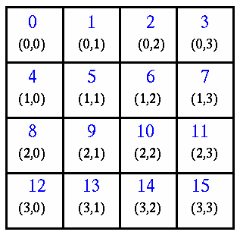
Virtual Topologies
Virtual topology describes a mapping/ordering of MPI processes into a geometric “shape.”
The two main types of topologies supported by MPI are Cartesian (grid) and graph.
Cartesian topology might prove convenient for an application that requires four-way nearest-neighbor communications for grid-based data.
MPI topologies are virtual—there may be no relation between the physical structure of the parallel machine and the process topology.
16 processors organized to 2D Cartesian communicator
Notes:
Most frequent use of communicators is for creating virtual topologies. A Topology describes a mapping of mpi processes into a geometric shape.
Two main types of topologies in mpi are cartesian (multidimensional grid) and a graph topology.
For example, the cartesian topology is useful when an application requires 4-way nearest neighbor communication for grid based data. Or for matrix operations, where we want to use matrix rows or columns.
Note that topologies are virtual, this means that there may be no relation between physical structure of the parallel machine (cluster) and the topology. MPI processes which are neighbors in a virtual topology may be physically located on distant nodes. But in some supercomputers, for example in blue gene, mpi allows to create a virtual topology which matches the physical topology.

Slide 22
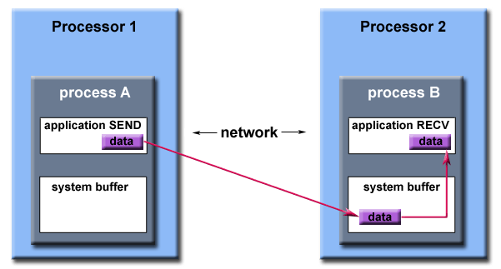
MPI: Point-to-Point Operations
General approach: message passing between two nodes
Process A calls SEND
Process B calls RECV
Source: https://computing.llnl.gov/tutorials/mpi/
Notes:
The most Basic MPI operations are point-to-point. This requires a coordinated action of two nodes: node A calls the SEND primitive, node B calls the RECEIVE primitive. Node B will wait until bytes are transferred from node A to node B through the network and placed in a certain memory location.
Point-to-point operations can be of two types: blocking and non-blocking.
Memory needs to be conserved
In blocking operations the SEND call will not return until the sending buffer is safe to modify, that is data has been copied to some system buffer or already transmitted via network to receiving node’s buffer. Using blocking operations is easier to program, but may lead to non-optimal performance because process is idle while it waits for communication to complete.
Non-blocking point-to-point operations return immediately without waiting for copying the data to the system buffer or transmitting through network. User has to take care of not modifying the buffer before data was actually transmitted by using WAIT routines. However, this approach allows to overlap computations and communication, thus achieving higher performance.
You need to call receive before a send. ☺
System buffer is only for receving ☺

Slide 23
MPI: Point-to-Point Operations
Types of point-to-point operations
Blocking
Process A SEND call will not return until sending buffer is safe to modify (i.e., data has been copied to some system buffer or already transmitted to process B)
Non-blocking
Return immediately
Simply request MPI library to perform SEND/RECV operation
User cannot predict when the data will actually be transmitted
Not safe to modify buffer until transmission is completed (there are special WAIT routines)
Used to overlap computations and communication
Source: https://computing.llnl.gov/tutorials/mpi/
Notes:
The most Basic MPI operations are point-to-point. This requires a coordinated action of two nodes: node A calls the SEND primitive, node B calls the RECEIVE primitive. Node B will wait until bytes are transferred from node A to node B through the network and placed in a certain memory location.
Point-to-point operations can be of two types: blocking and non-blocking.
Memory needs to be conserved
In blocking operations the SEND call will not return until the sending buffer is safe to modify, that is data has been copied to some system buffer or already transmitted via network to receiving node’s buffer. Using blocking operations is easier to program, but may lead to non-optimal performance because process is idle while it waits for communication to complete.
Non-blocking point-to-point operations return immediately without waiting for copying the data to the system buffer or transmitting through network. User has to take care of not modifying the buffer before data was actually transmitted by using WAIT routines. However, this approach allows to overlap computations and communication, thus achieving higher performance.
You need to call receive before a send. ☺
System buffer is only for receving ☺

Slide 24
MPI: Point-to-Point Operations (Examples)
MPI_Send(void* data, int count, MPI_Datatype datatype, int destination, int tag, MPI_Comm communicator)
MPI_Recv(void* data, int count, MPI_Datatype datatype, int source, int tag, MPI_Comm communicator, MPI_Status* status)
Send and receive data
of type `datatype`
from buffer `data`
of length `count`
to the process with rank `destination` (or from process with rank `source`) within communicator `communicator`.
MPI_Datatype options: MPI_BYTE, MPI_INT, MPI_DOUBLE, and so on
Notes:
Simplest point-to-point operation is MPI_Send/MPI_Recv. Remember that node A has to call MPI_Send, and node B has to call corresponding MPI_Recv. If MPI_Recv is not called, node A will hang on MPI_Send forever.
Send and Recv subroutines have an almost identical set of parameters: pointer to buffer data, number of elements, datatype, source or destination rank, communicator.
These operations are blocking. There are multiple similar non-blocking alternatives. Please refer to MPI tutorial containss more detail
MPI status field is populated automatically

Slide 25
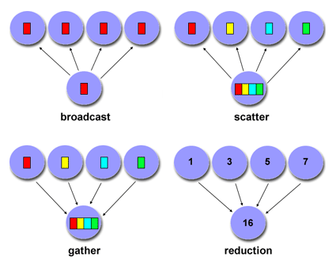
MPI: Collective Operations
Communication between all processes of a group
One-to-many
Broadcast
Scatter
Many-to-one
Gather
Reduction
All-to-all
Barrier
Source: https://computing.llnl.gov/tutorials/mpi/
Notes:
Another important type of MPI operations are collective, where one processors sends or receives data from all processors within communicator. Communicators are created by the user to implement certain logic, for example assign odd ranks to one communicator and even ranks to the other. Or, create a 2D communicator, where each node has 2 coordinates (proc_row, proc_col) and use this communicator for distributing a matrix by blocks.
There are several collective operations available: broadcast, scatter, gather, reduction, as well as many others.
In broadcast one node sends same data to all other processors in a communicator. This is often used when one processor has read input data from file and sends it to all other processors. We do not want 10000 processors to access same file, right? So we assign one processor to be reader and then broadcast parameters via network.
Scatter is similar, but each processor will receive different portion of array which is being broadcasted – see picture.
Gather is the opposite for Scatter: one processor gathers computed portions of array to its buffer.
Reduction is operation where data is gathered and certain operation is performed on these data. For example, we want to find out which processor has maximum value of some variable, or calculate total sum of these values within communicator.
All processes in a communicator need to make the same exact blocking call.

Slide 26
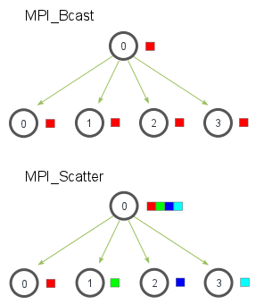
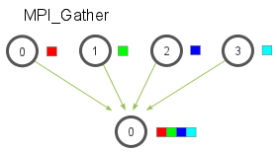
MPI: Collective Operations
Broadcast MPI_Bcast(void* data, int count, MPI_Datatype datatype, int root, MPI_Comm communicator)
Scatter MPI_Scatter(void* send_data, int send_count, MPI_Datatype send_datatype, void* recv_data, int recv_count, MPI_Datatype recv_datatype, int root, MPI_Comm communicator)
Gather MPI_Gather(void* send_data, int send_count, MPI_Datatype send_datatype, void* recv_data, int recv_count, MPI_Datatype recv_datatype, int root, MPI_Comm communicator)
Image source: http://mpitutorial.com
Notes:
In the illustration, MPI_Bcast takes a single data element at the root process (the red box) and copies it to all other processes. MPI_Scatter takes an array of elements and distributes the elements in the order of process rank. The first element (in red) goes to process zero, the second element (in green) goes to process one, and so on. Although the root process (process zero) contains the entire array of data, MPI_Scatter will copy the appropriate element into the receiving buffer of the process.
MPI_Gather is the inverse of MPI_Scatter. Instead of spreading elements from one process to many processes, MPI_Gather takes elements from many processes and gathers them to one single process. This routine is highly useful to many parallel algorithms, such as parallel sorting and searching.
Similar to MPI_Scatter, MPI_Gather takes elements from each process and gathers them to the root process. The elements are ordered by the rank of the process from which they were received. The function prototype for MPI_Gather is identical to that of MPI_Scatter.
In MPI_Gather, only the root process needs to have a valid receive buffer. All other calling processes can pass NULL for recv_data. Also, don’t forget that the recv_count parameter is the count of elements received per process, not the total summation of counts from all processes. This can often confuse beginning MPI programmers.

Slide 27
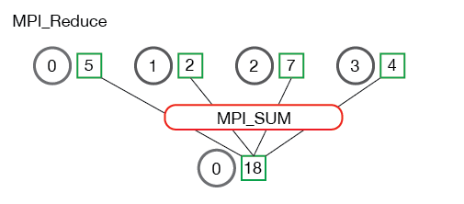
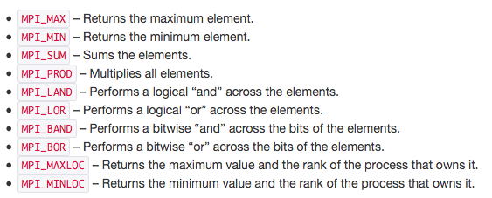
MPI: Collective Operations
Reduction MPI_Reduce( void* send_data, void* recv_data, int count, MPI_Datatype datatype, MPI_Op op, int root, MPI_Comm communicator)
Image source: http://mpitutorial.com
Notes:
Similar to MPI_Gather, MPI_Reduce takes an array of input elements on each process and returns an array of output elements to the root process. The output elements contain the reduced result.
The send_data parameter is an array of elements of type datatype that each process wants to reduce. The recv_data is only relevant on the process with a rank of root. The recv_data array contains the reduced result and has a size of sizeof(datatype) * count. The op parameter is the operation that you wish to apply to your data. MPI contains a set of common reduction operations that can be used. Although custom reduction operations can be defined, it is beyond the scope of this lesson. The reduction operations defined by MPI are listed on the slide.
In the above, each process contains one integer. MPI_Reduce is called with a root process of 0 and using MPI_SUM as the reduction operation. The four numbers are summed to the result and stored on the root process.

Slide 28
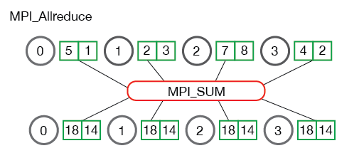
MPI: Collective Operations
Reduction MPI_Allreduce(
void* send_data,
void* recv_data,
int count,
MPI_Datatype datatype,
MPI_Op op,
MPI_Comm communicator)
MPI_Allreduce is the equivalent of doing MPI_Reduce followed by an MPI_Bcast

Slide 29
Typical Workflow of Running MPI Program
User SSHs to
login node
Login (frontend) node
idle
compute
nodes
Storage:
Parallel FS
GPFS/Lustre/…
Nodes
taken by
user A
Nodes
taken by
user B
Supercomputer
Notes:
Working with supercomputers is a bit different from working with Hadoop clusters.
As we already learned, a supercomputer is a vast collection of nodes – processors – which we have been calling compute nodes. These nodes are designed to run computation and nothing else, so on many supercomputers they even run a reduced version of operating system which eliminates all possible interruptions and noise.
So, here we see a supercomputer. Some of its nodes are already busy working on other’s people’s tasks and some are free.
There is a so-called frontend node in front of the supercomputer. This is a server where people log in, compile their code and send their programs to the supercomputer for execution.
Storage is also connected to both frontend node and supercomputer. During execution, compute nodes store result on the high performance file system, such as GPFS or Lustre. User can also access this data from the frontend node.

Slide 30
Typical Workflow of Running MPI Program
User SSHs to
login node
Login (frontend) node
idle
compute
nodes
User asks to
run his program
on four nodes
Storage:
Parallel FS
GPFS/Lustre/…
Nodes
taken by
user A
If there is enough idle
nodes, user’s program is started, otherwise it is put on queue
Nodes
taken by
user B
Supercomputer
Notes:
So, now the user has compiled his program and wants to run it on a supercomputer. Large supercomputers usually have some scheduling system, so user can only put their request to the queue. A Scheduling system will then look to see if requested resources are available. If yes, the requested number of nodes is allocated exclusively to this user and his program is started. Otherwise request is put on queue and will be started automatically when resources become available.
There are a number of different schedulers – and also allow you to reserve slots in advance because the resources are finite
Compare this to the cloud model where the resources are transient!

Slide 31
Running MPI Programs
mpirun command is performed from the login node
Either directly (on small clusters)
Or through scheduling system (e.g., SLURM, Torque, LoadLeveler, etc.)
mpirun or scheduling system
Ensures that enough nodes are available
If nodes are not available:
mpirun will try to re-use existing (busy) processors in multi-tasking mode—never is done in production
Scheduling system will put task on queue and start as soon as resources become available
Allocates requested number of nodes within supercomputer
Starts copy of program binary on all nodes simultaneously
When MPI program is started on multiple nodes, copies running on nodes start to communicate via network
Notes:
To run program written in MPI you need to invoke it through the mpirun script. Mpirun is called either directly, or through a scheduling system. If you installed mpi on your local computer or your small cloud cluster to make homework, you will use the mpirun command directly.
Mpirun finds which cluster nodes it can use. When MPI is set up, it needs to have list of available host names, where mpirun can start programs.
In theory, nodes can be used by MPI in the multitasking (overprovisioned) mode – for example you can ask mpirun to run your hello world on 5 or 10 mpi processes, even if you are physically on a laptop with just 1 processor with two cores. In this case mpirun will reuse your one processor and program will think that it runs on 5 or 10 processors. However, this approach is never used in production mode on large supercomputers. Users usually pay for processor time, so we want to be sure that at least no other users will use same processors. Also, multitasking rarely adds performance in HPC algorithms, so it is not used.
Compare this to the cloud, where many – most VMs are idle!

Slide 32
GPUDirect and RDMA
Main ideas
There will be a lot of data movement, so:
Simplify the stack involved in GPU to GPU communication locally
Same over the network
Reduce latency, increase bandwidth
Reduce CPU usage
RDMA: remote direct memory access
Do not use CPU, OS, cache, and so on

Slide 33
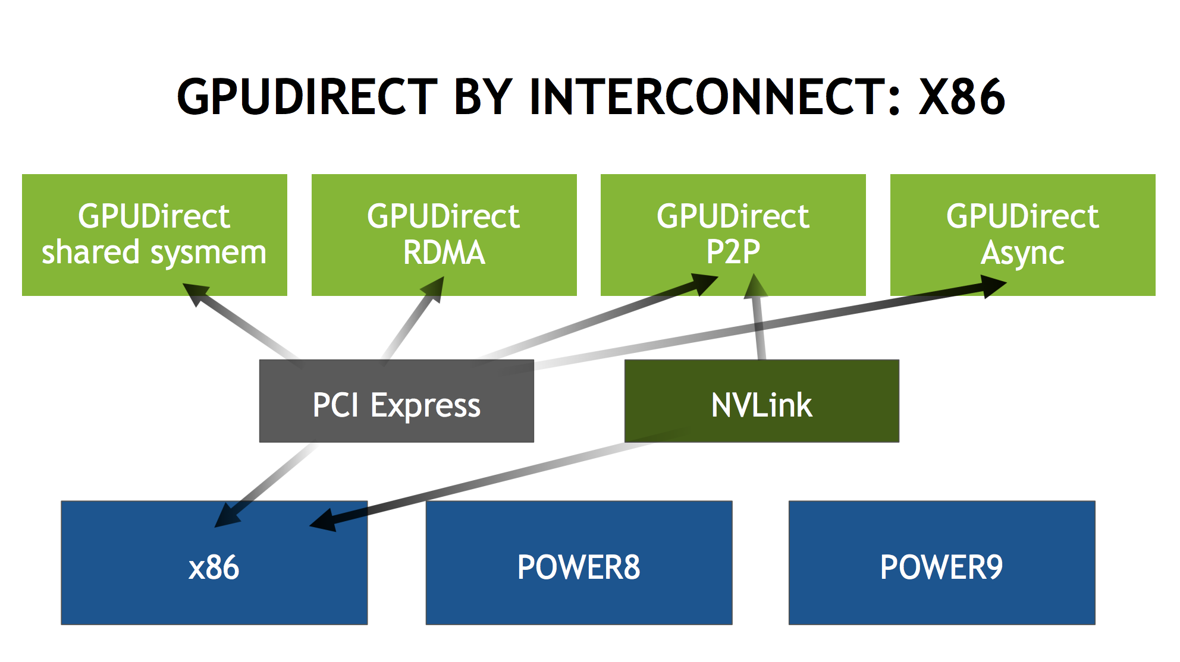
Types of GPUDirect
Source: http://on-demand.gputechconf.com/gtc/2018/presentation/s8474-gpudirect-life-in-the-fast-lane.pdf

Slide 34
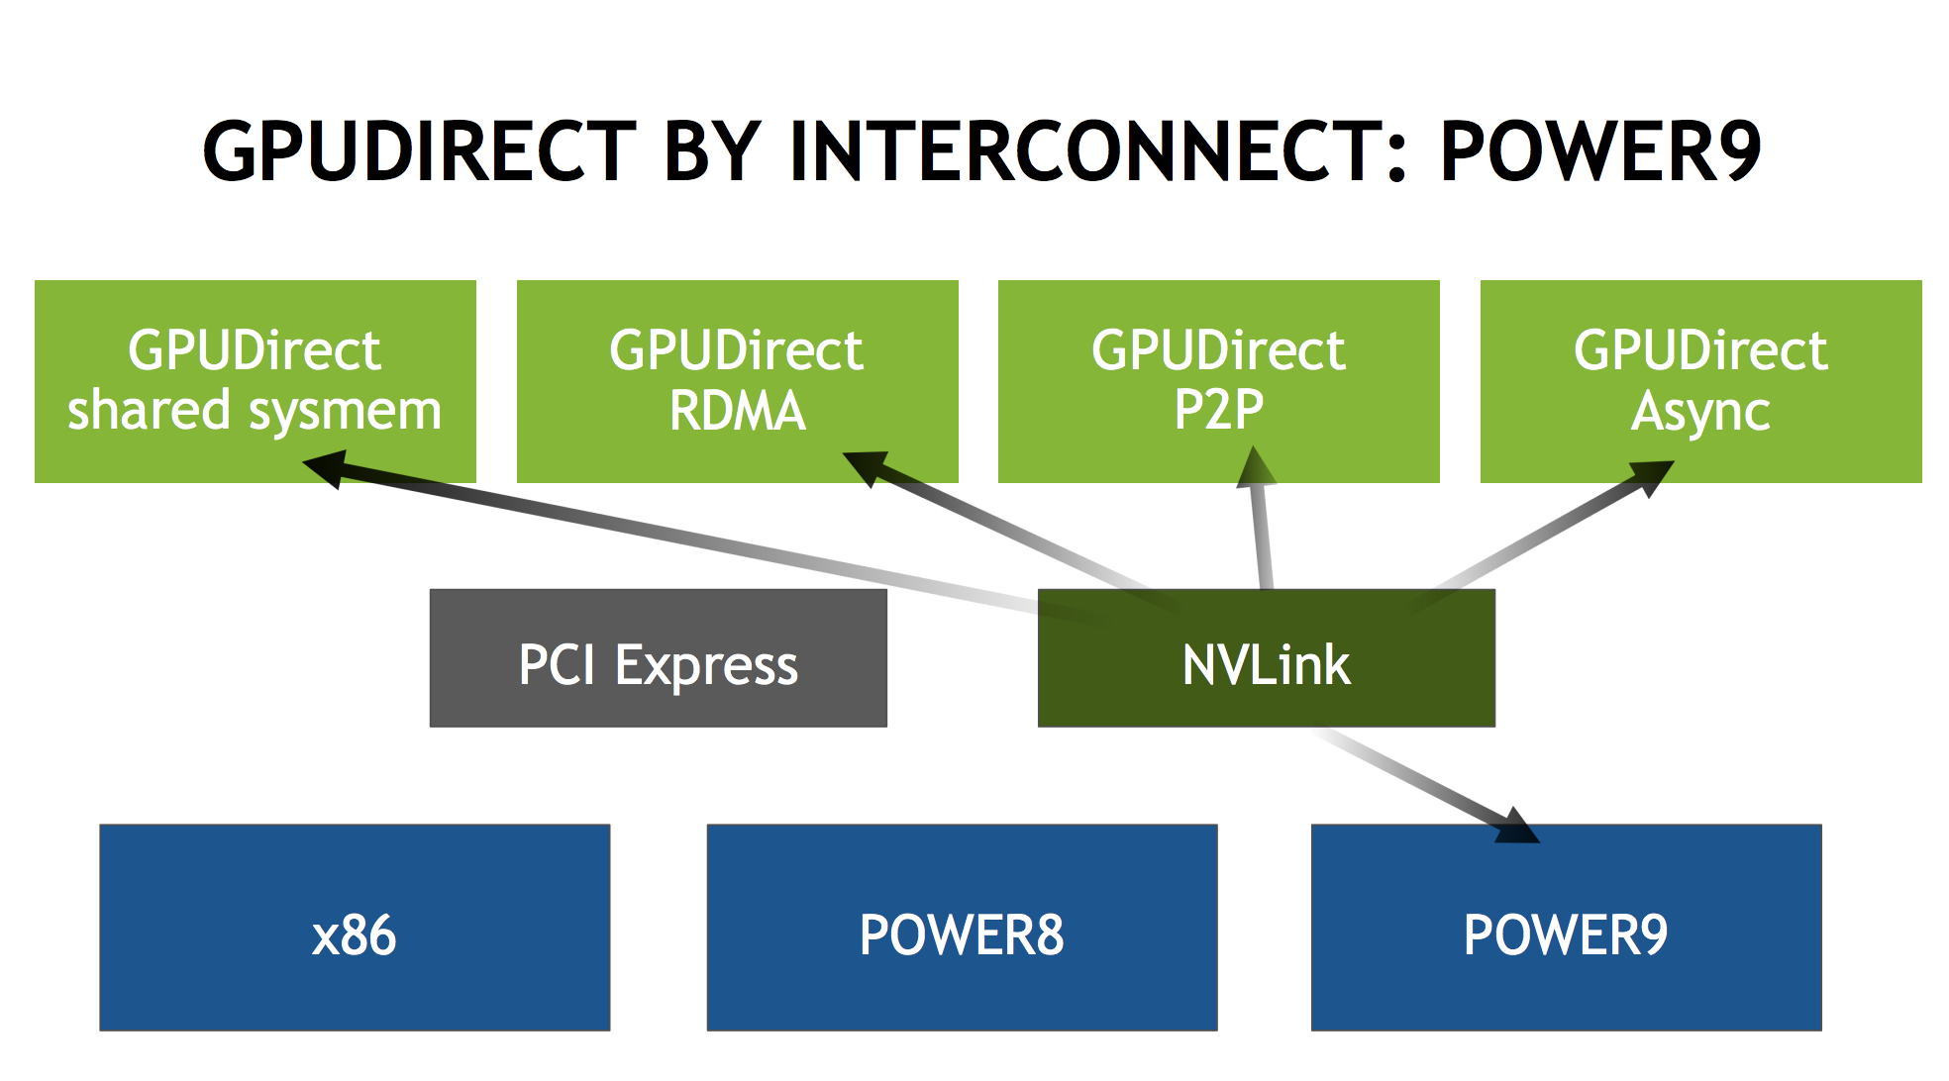
IBM Power 9
Source: http://on-demand.gputechconf.com/gtc/2018/presentation/s8474-gpudirect-life-in-the-fast-lane.pdf

Slide 35
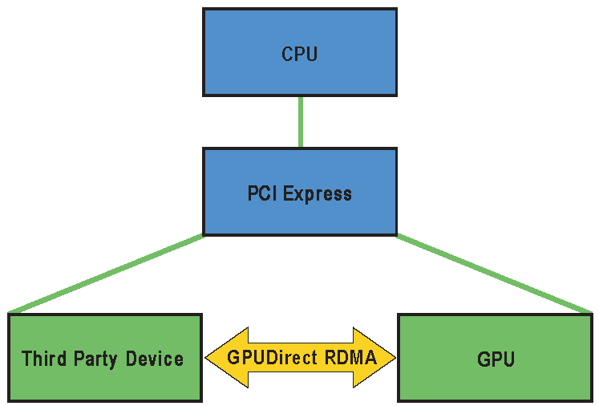
GPUDirect: Avoid Using CPU
Accelerated communication with network and storage devices Network and GPU device drivers can share “pinned” (page-locked) buffers, eliminating the need to make a redundant copy in CUDA host memory
Peer-to-peer transfers between GPUs Use high-speed DMA transfers to copy data between the memories of two GPUs on the same system/PCIe bus
Peer-to-peer memory access Optimize communication between GPUs using NUMA-style access to memory on other GPUs from within CUDA kernels

Slide 36
GPUDirect: Avoid Using CPU
RDMA Eliminate CPU bandwidth and latency bottlenecks using remote direct memory access (RDMA) transfers between GPUs and other PCIe devices, resulting in significantly improved MPISendRecv efficiency between GPUs and other nodes)
GPUDirect for video This is an optimized pipeline for frame-based devices such as frame grabbers, video switchers, HD-SDI capture, and CameraLink devices

Slide 37
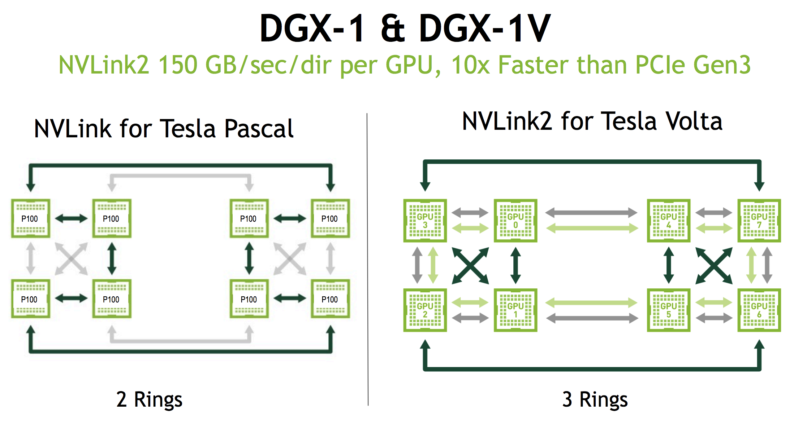
NVIDIA DGX-1

Slide 38
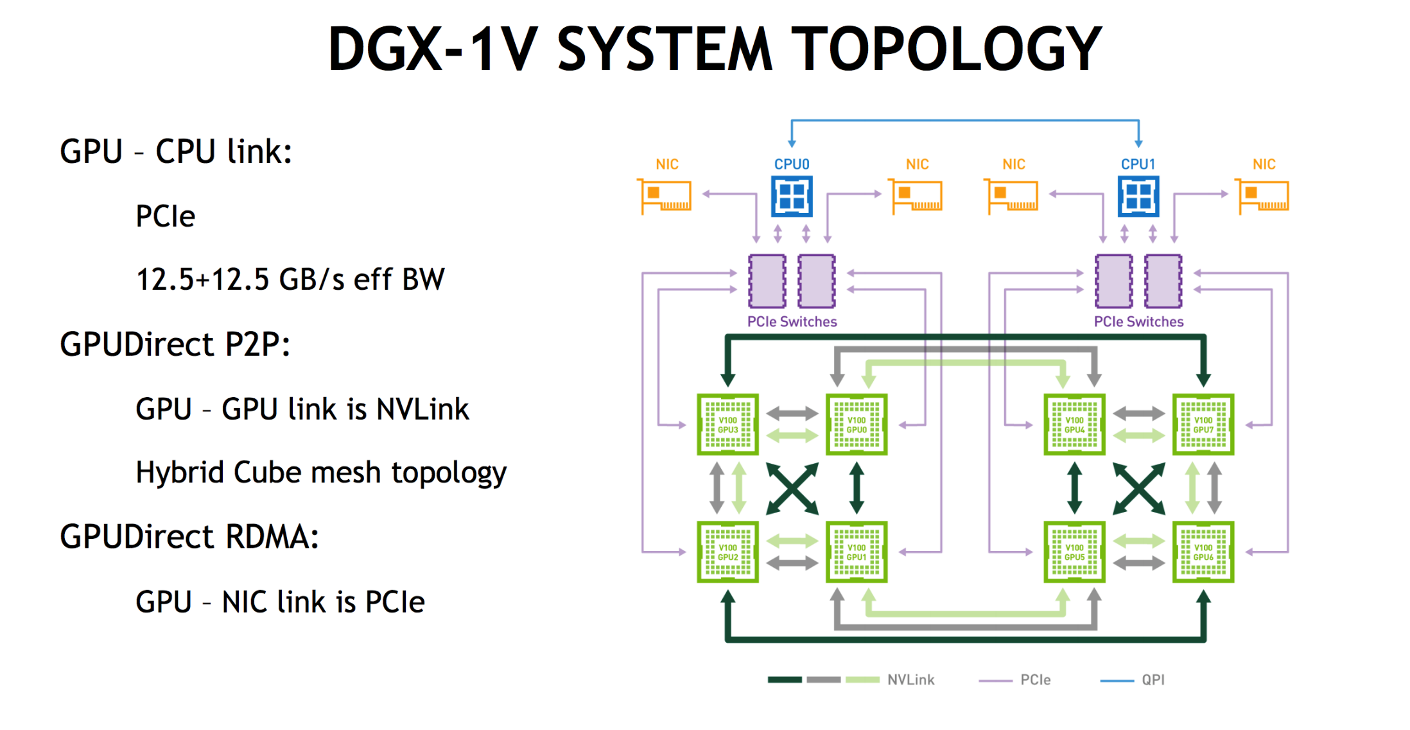
NVIDIA DGX-1

Slide 39
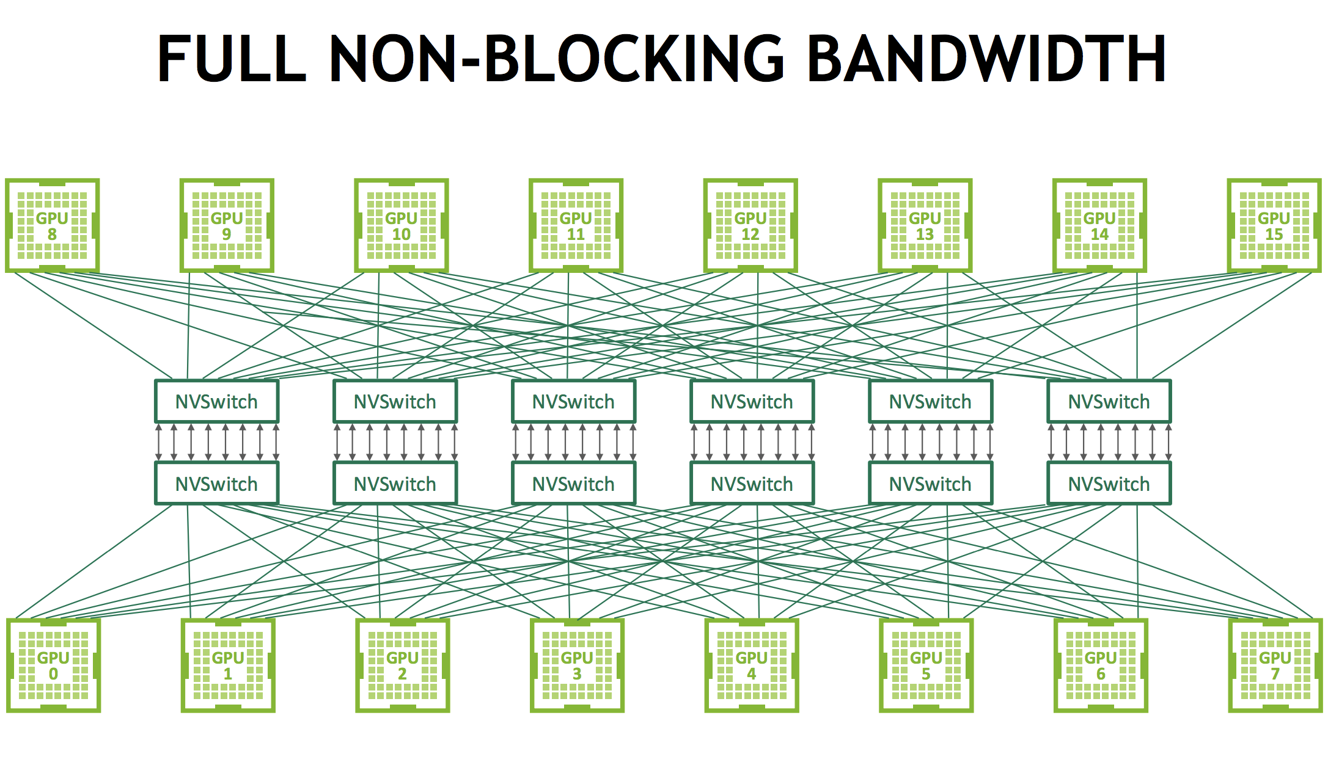
NVIDIA DGX-2

Slide 40
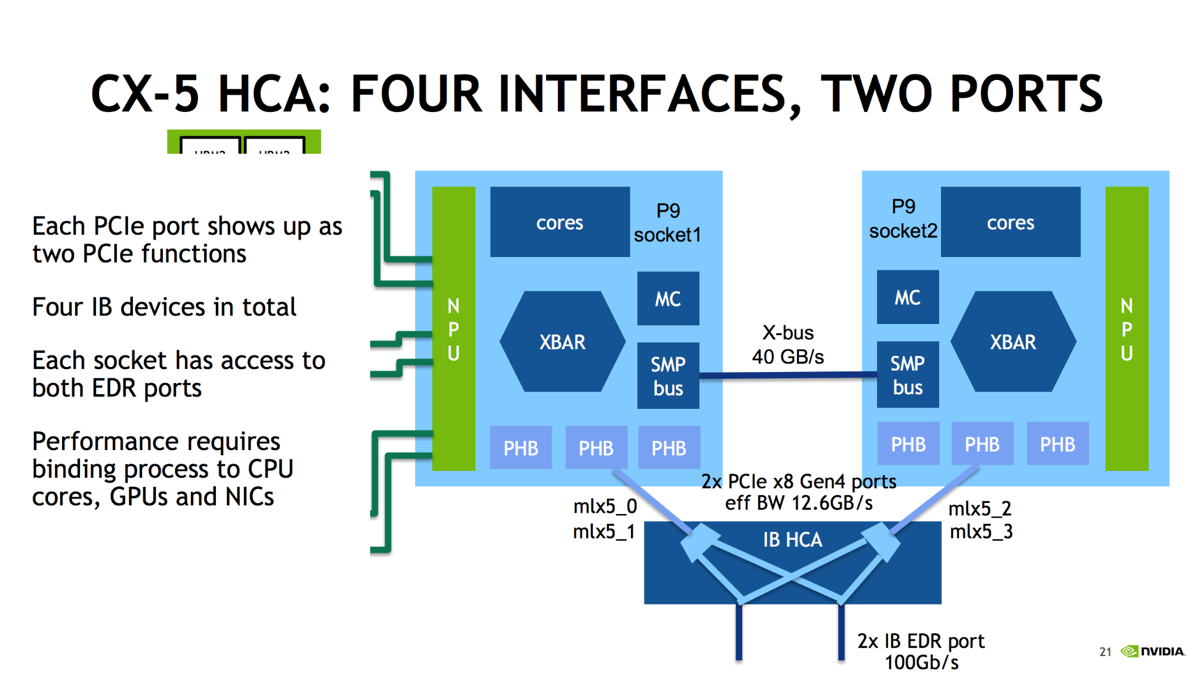
IBM Power 9 GPUDirect Flows

Slide 41
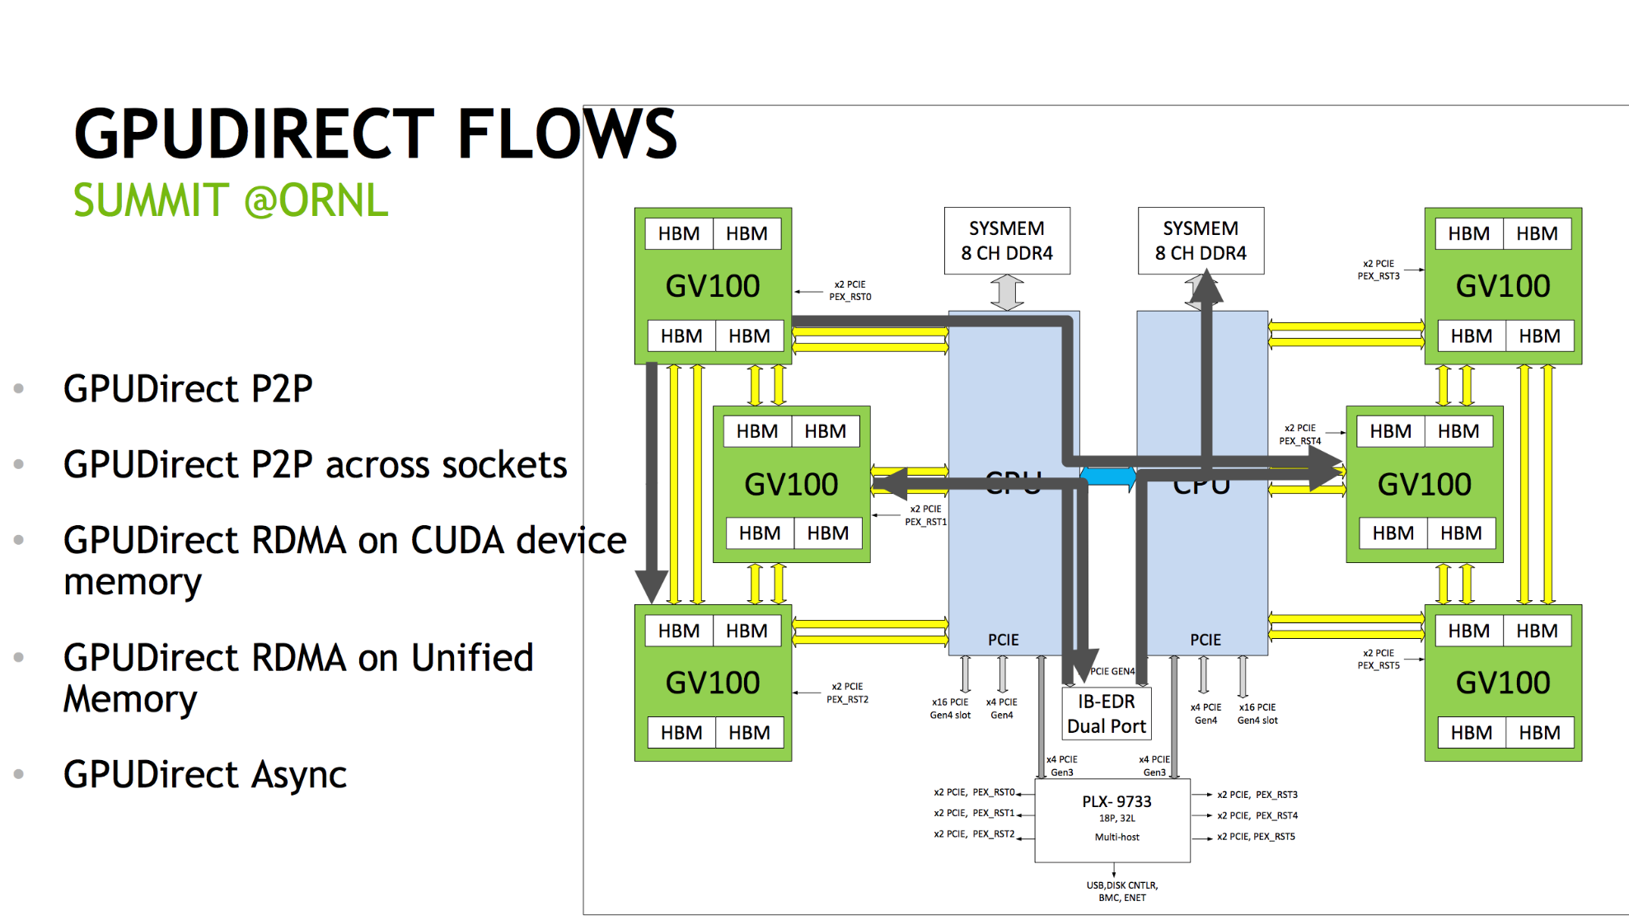
The Summit

Slide 42
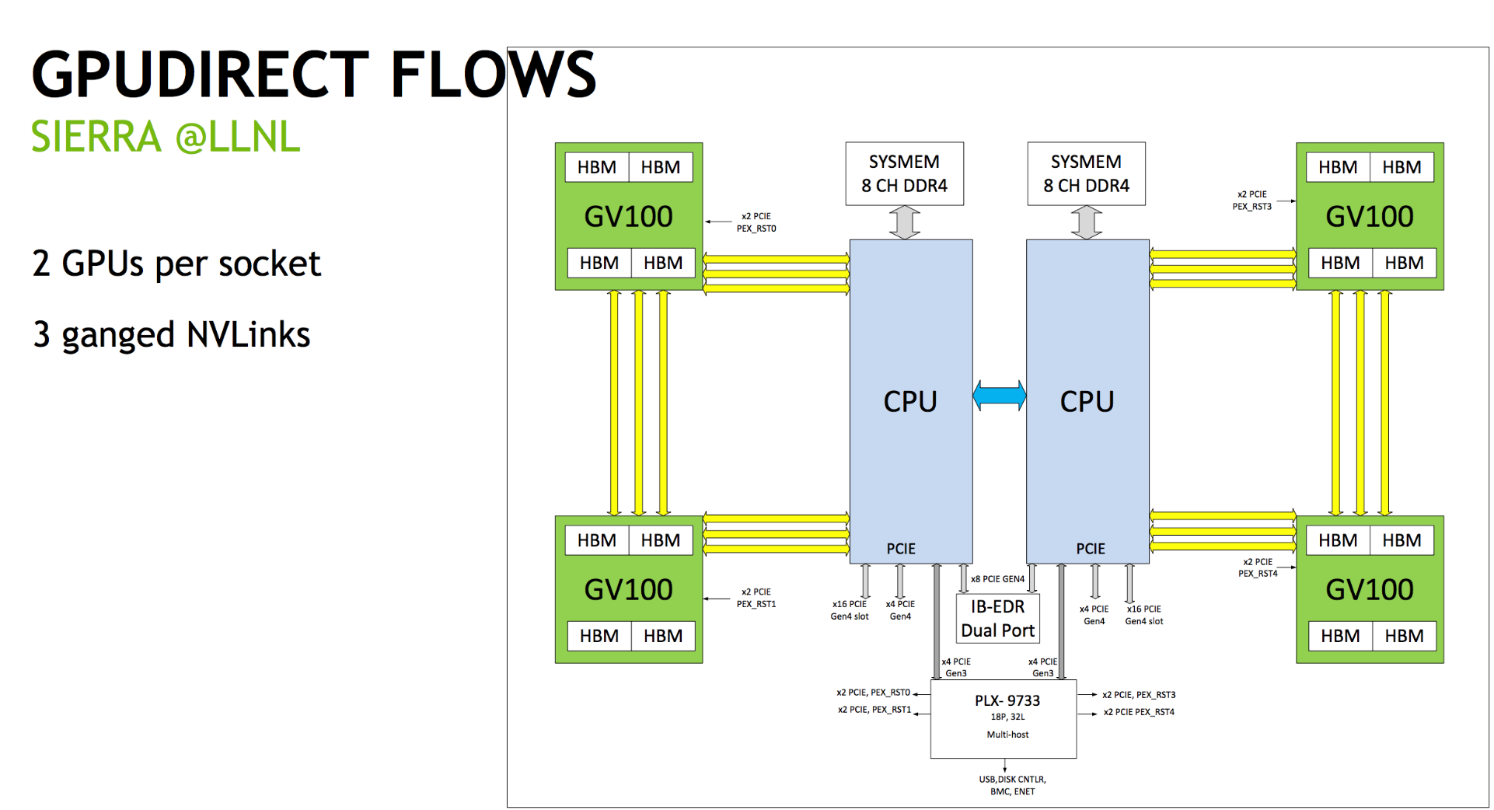
The Sierra

Slide 43
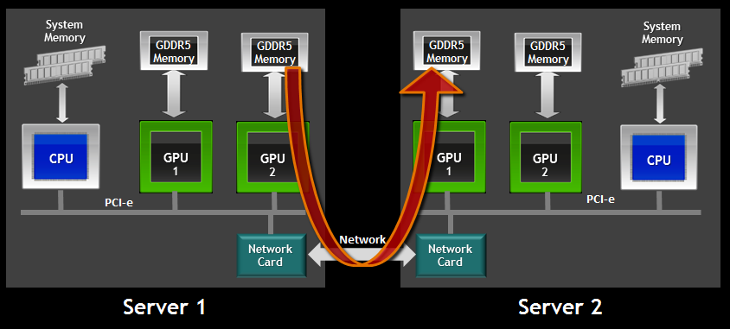
RDMA With GPUDirect

Slide 44
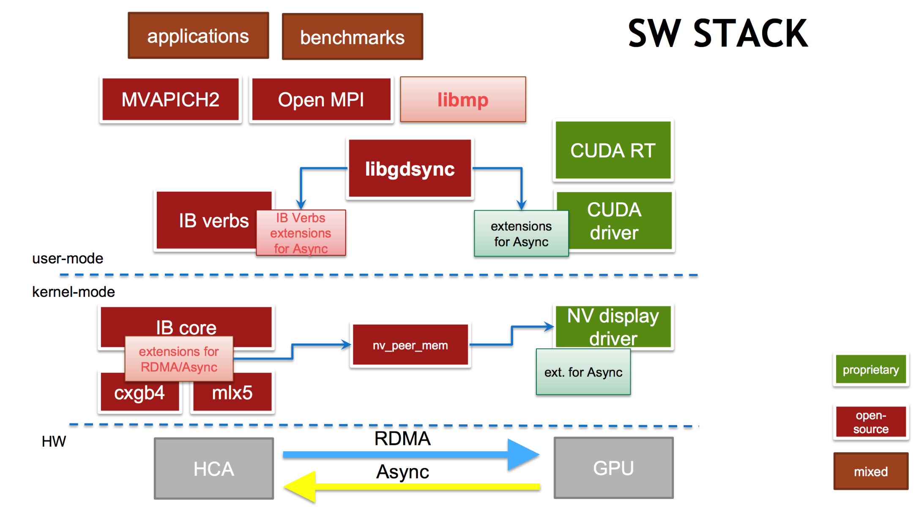
The Software Stack

Slide 45
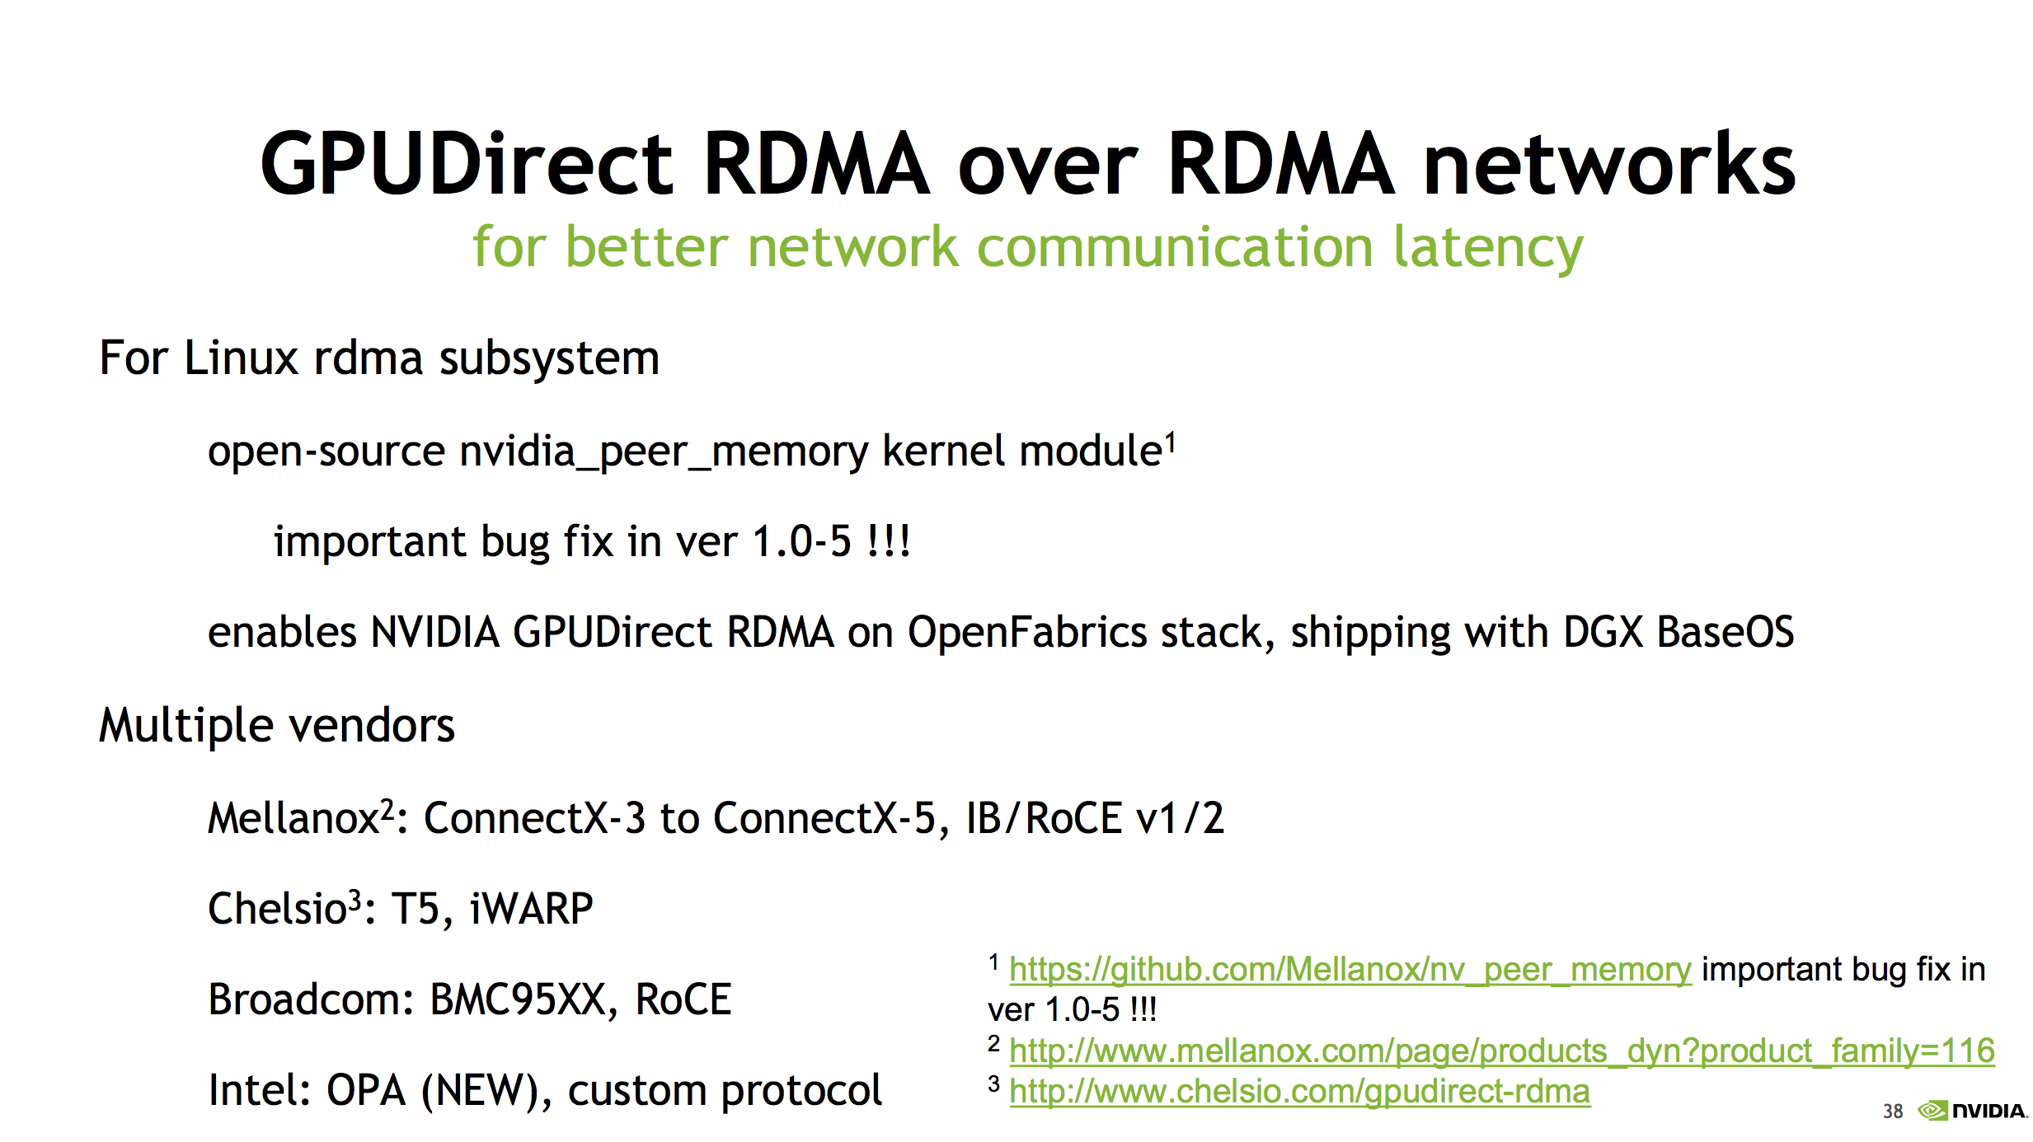

Slide 46
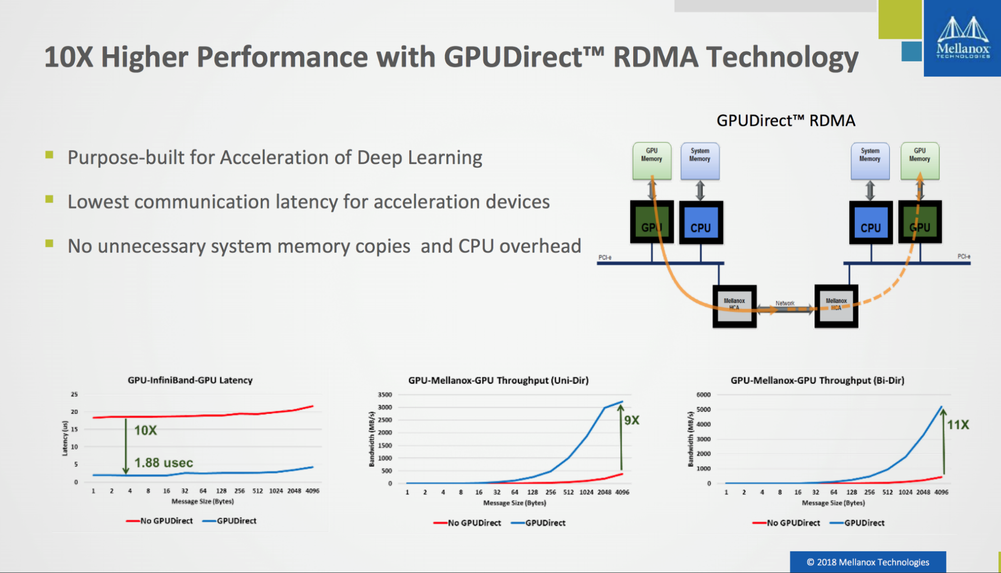
GPUDirect RDMA Performance
Source: http://on-demand.gputechconf.com/gtc/2018/presentation/s8474-gpudirect-life-in-the-fast-lane.pdf

Slide 47
TCP/IP and Ethernet
Very well established and commonplace
Commodity
Today, 10 GE is standard (25 GE for some cloud providers)
Inexpensive

Slide 48
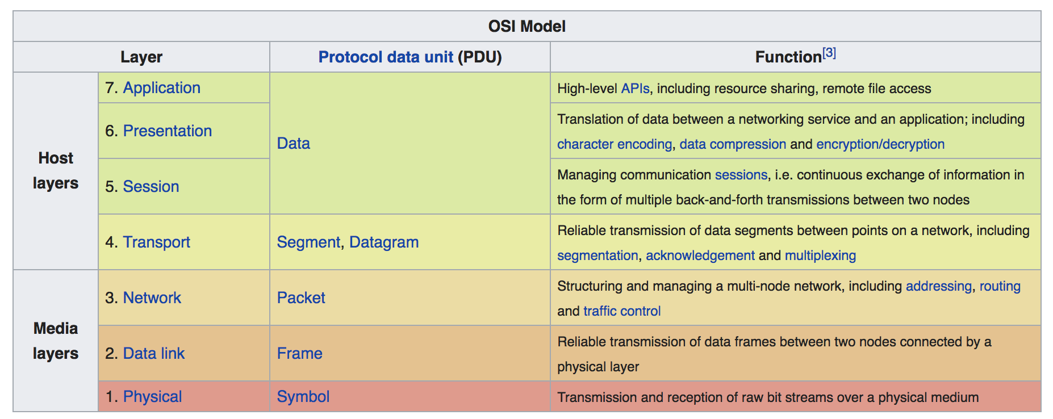
The Open Systems Interconnection (OSI) Model

Slide 49
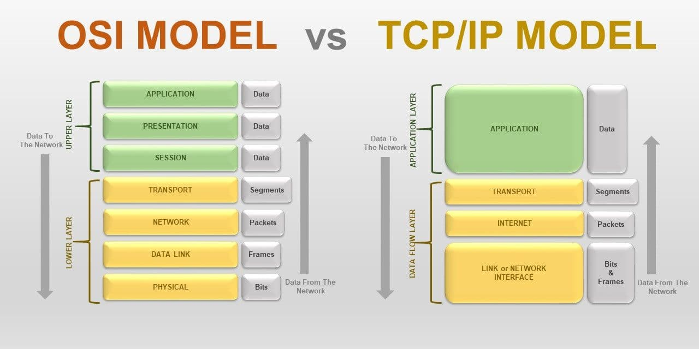
OSI Model vs. TCP/IP Model
https://www.stemjar.com/osi-vs-tcp-ip-model/

Slide 50
TCP/IP Challenges
Goes through the OS
Goes through CPU
Potentially, multi-party drivers
Does not work very well over long distances
Effective socket throughput limited

Slide 51
InfiniBand (IB)
Networking standard originated in 1999
InfiniBand Trade Association (IBTA): IBM, Dell, HP, Intel, Microsoft, Sun
OpenFabrics Alliance (OFA) defines the software stack
Today: Mellanox dominates (Intel also ships IB equipment)
Focus on latency
Widely adopted for demanding workloads, such as HPC

Slide 52
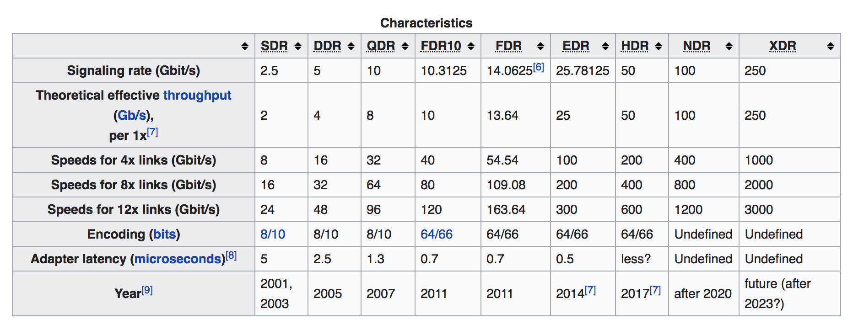
IB Types and Specs
Typical EDR IB
We are here

Slide 53
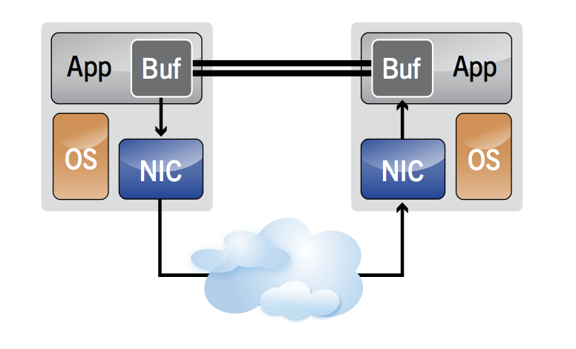
IB Verbs: Messaging
Applications have an ability to send and receive messages directly, without OS.
Don’t expect to see the IB traffic using OS-level tools like nmon!

Slide 54
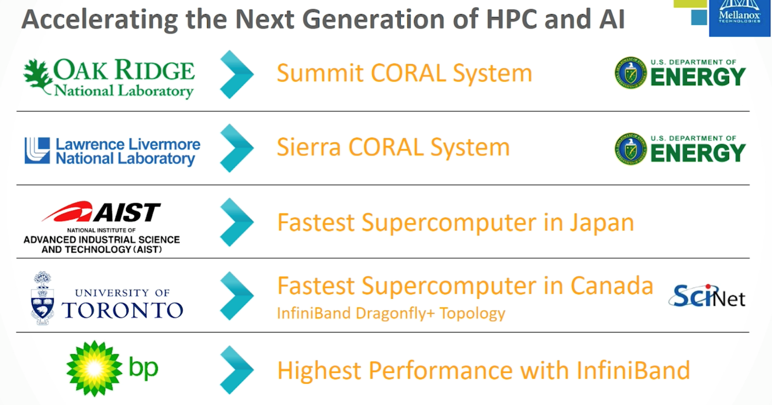
Adoption of IB

Slide 55
Distributed Model Training
Means multi-GPU and multi-node training
Takes a long time, tens to hundreds of days
Networks simply don’t fit into memory

Slide 56
Model Parallelism
Different layers of the model are placed on different GPUs
GPU 0
GPU 1

Slide 57
Data Parallelism (Mirroring)
Data and network are copied to all participating GPUs
GPU 0
GPU 1

Slide 58
Focus: Data Parallelism
Today’s GPUs have 32G of memory.
A DGX-2 has 16 such GPUs.
There are few networks that don’t fit into memory.

Slide 59
Observations
The more data (the bigger the batch) you give each GPU, the less frequently they will communicate.
The faster the GPU, the more frequently they will communicate.
The more computationally intensive a network is, the less they will communicate.

Slide 60
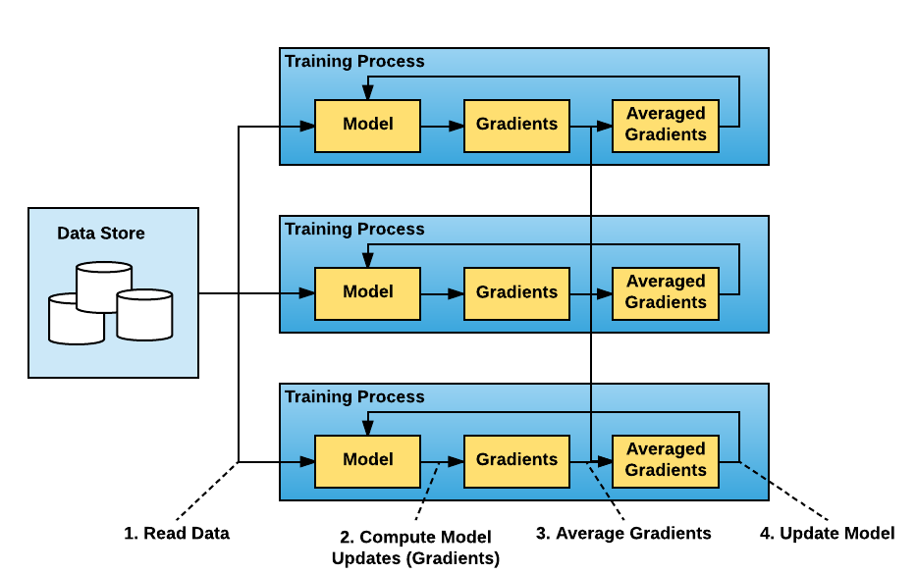
What We Want
Train across multiple nodes.
Things should just work.
Image source: https://eng.uber.com/horovod/

Slide 61
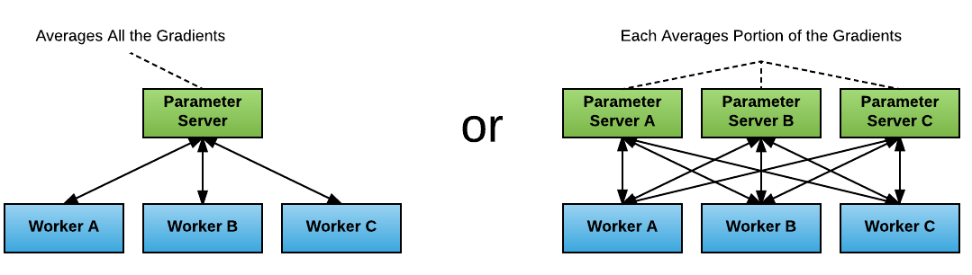
Data Parallelism Approaches
Image source: https://eng.uber.com/horovod/
Simple
Built into TensorFlow
Works OK on a small scale
Requires CPU
Relatively slow
Much, much faster
Take CPU out of the loop

Slide 62
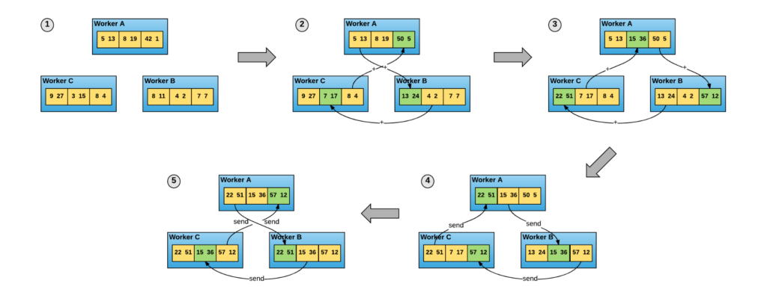
Ring All Reduce
Each of the N nodes communicates with its two neighbors 2 * (N – 1) times
Image: https://eng.uber.com/horovod/
Paper: http://www.cs.fsu.edu/~xyuan/paper/09jpdc.pdf

Slide 63
Uber Horovod
Distributed as a Python package
Independent of TF versions
Uses NVIDIA NCCL2.X for low-level communication
Uses GPUDirect, IB Verbs, RDMA
Included with TF today

Slide 64
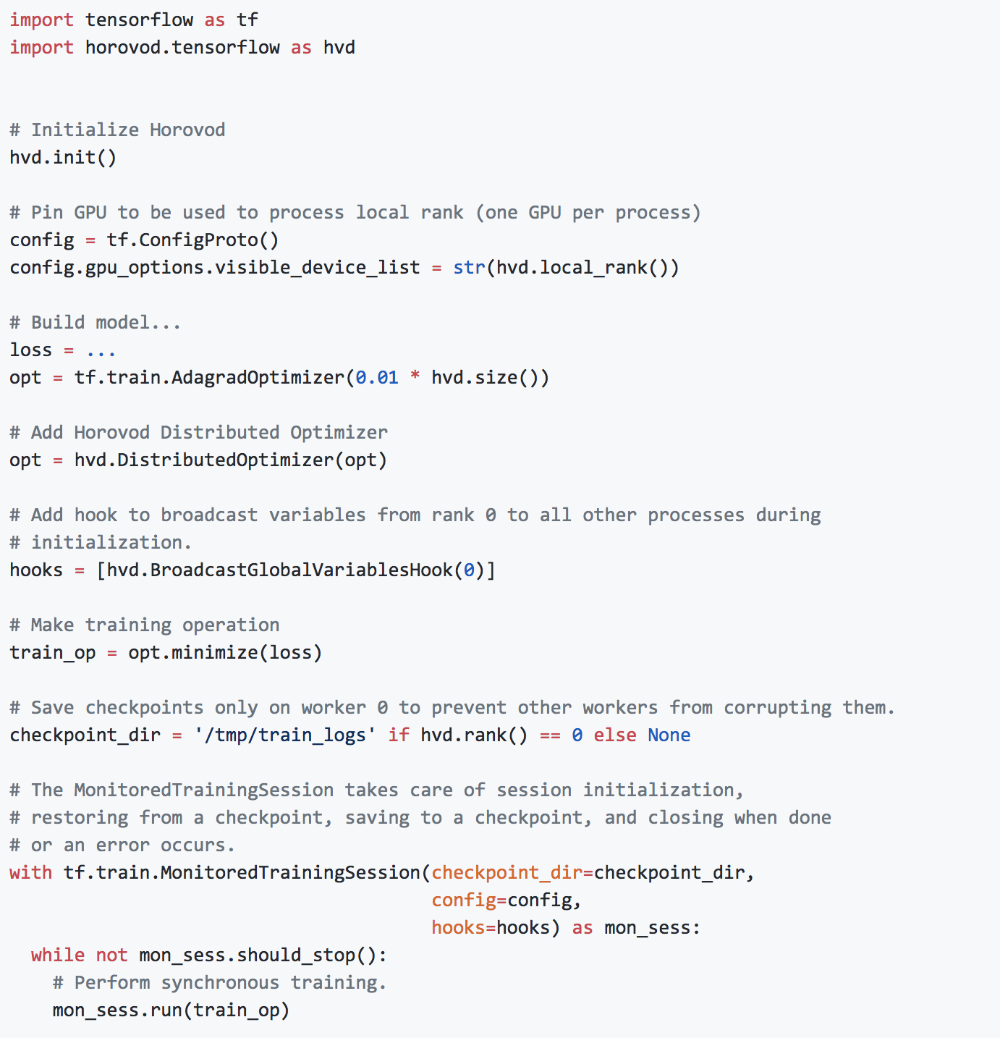
Using HVD

Slide 65
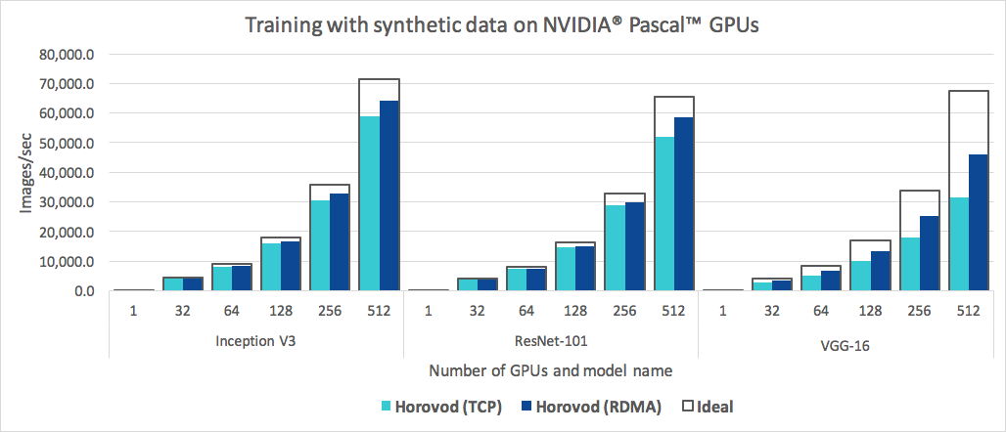
Horovod on P-100 GPUs

Slide 66
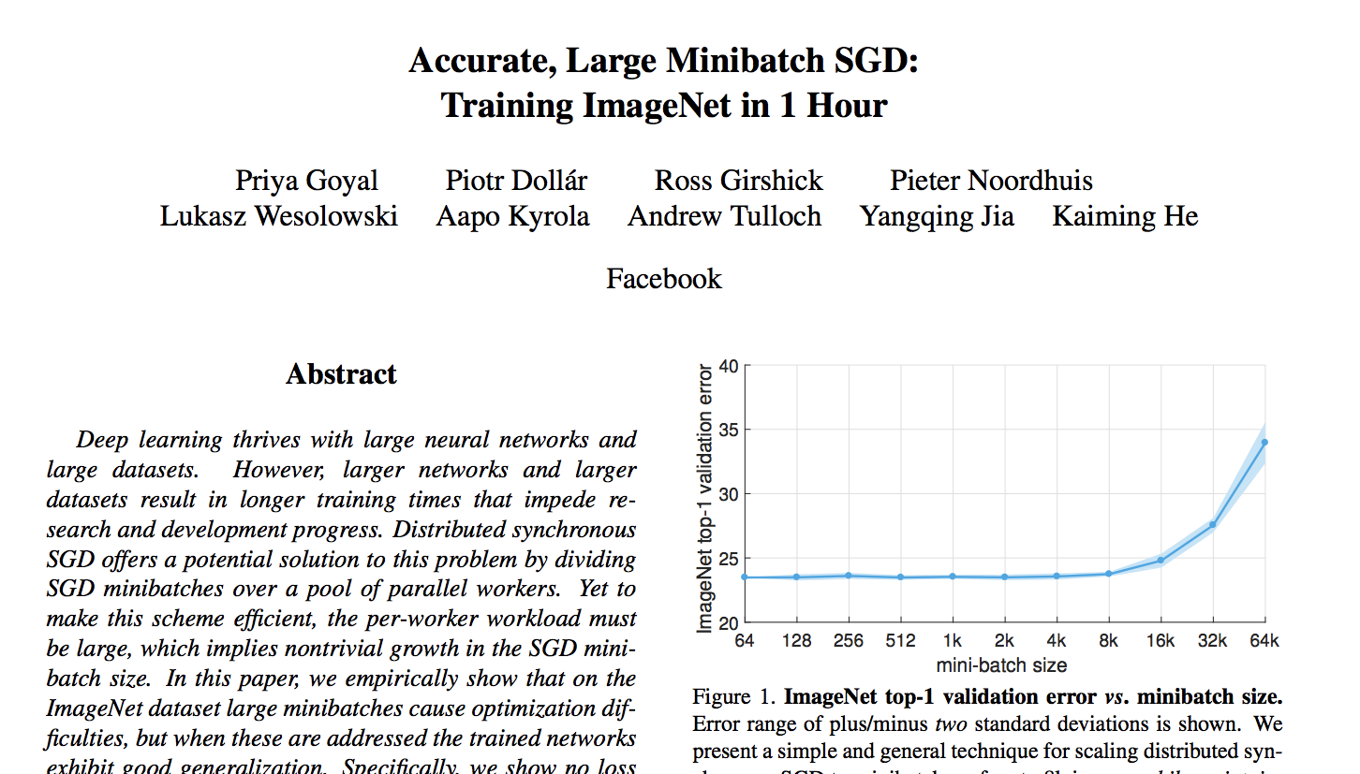
Distributed Training
The promise: linear scaling of clock time
Going beyond one machine

Slide 67
Distributed Training: Challenges
Scalability
Latency of the interconnects
Speed of the interconnects
Algorithm efficiency
Increase the batch size
Convergence
Adjust the learning rate

Slide 68
A Good Candidate for Distributed Training?
There are numerous
Efforts on “better” vs. “faster/cheaper” happen in parallel
Language-to-language translation (e.g., GNMT) is a good candidate
Speech generation (text to speech)
Speech to text
But, we’ll talk about GANs instead

Slide 69
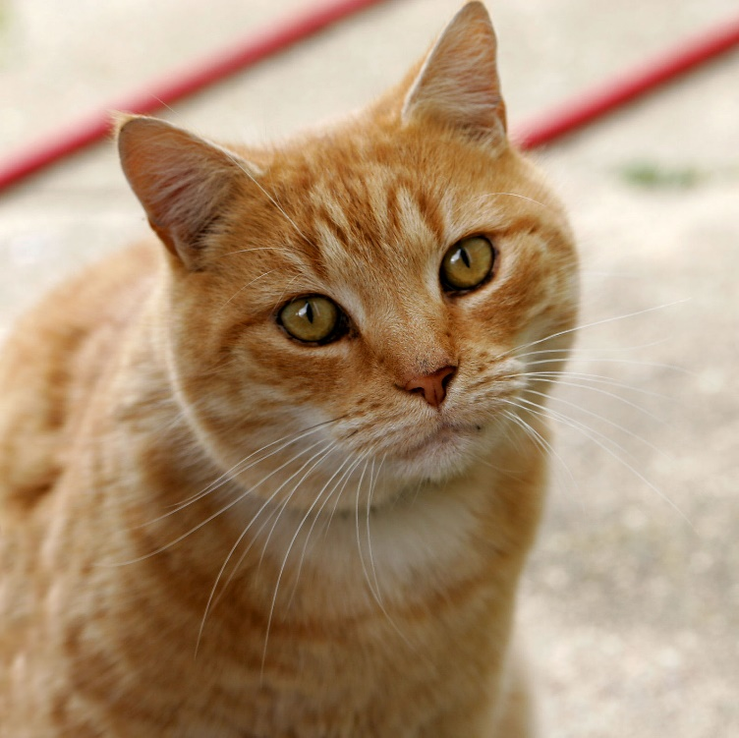

Generative Adversarial Networks (GANs)
General inspiration
vs.
Can a machine classify this?
Can a machine generate this?
Image: https://en.wiktionary.org/wiki/cat#/media/File:Cat03.jpg
Image: https://anters.org/2018/02/01/wcb012/

Slide 70

Actually…
It’s about generating images that are indistinguishable from originals
vs.
Can a machine classify this?
Can a machine generate this?
Image: https://upload.wikimedia.org/wikipedia/commons/8/8f/Burma_creme.JPG

Slide 71



Neural Style Transfer (Not to Be Confused With…)
Extract features
Extract texture
Generate
https://github.com/jcjohnson/neural-style

Slide 72
Generator
Given an input vector, generate some output
V₁
Generator

Slide 73
Generator
Given a different input vector, generate a different output
V₂
Generator

Slide 74
Generator
Our input vector, then, contains the features
V₂
Generator
Features

Slide 75

Generator
More precisely, a “vanilla” vector should give us a “vanilla” cat
V_{cat}
Generator
Cat

Slide 76
Cat Algebra
Draw me a Burmese cat!
V₂ = V_{cat} + V_{Burmese}
Generator
Burmese cat
Cat features
Burmese features

Slide 77
GAN Intuition
Curriculum training
People: focus on the examples that are hard for us
Get better over time

Slide 78

GANs (2014)

Slide 79
Adversarial Training
“Training the model in the worst case scenario, with the inputs chosen by an adversary”
“Training the model in the worst case scenario, with the inputs chosen by an adversary”
Two players: both are neural networks
Worst-case input for one network is produced by another network

Slide 80
The Generator
Noise
Generator
Image
Hopefully, a realistic one!

Slide 81
Generator Training
Repeat
Noise
Generator
Image
Adjust weights
Backprop
Add a loss function

Slide 82
Add Discriminator
Repeat
Noise
Generator
Image
Adjust weights
Discriminator
Backprop
A trainable loss function

Slide 83
Training the Discriminator
Generated fake images
Real images
Backprop as usual
Discriminator
A trainable loss function
Real
Fake

Slide 84
Generator: Discriminator Game
Repeat
Train to minimize loss
Noise
Generator
Image
Adjust weights
Discriminator
Train to maximize loss
Backprop
A trainable loss function

Slide 85
Training the Generator
Noise
Generator
Image
Discriminator
loss
Adjust weights
Backprop
Backprop all the way back

Slide 86

GAN Basics
http://on-demand.gputechconf.com/gtc/2018/video/S8686/

Slide 87

Results From 2016 (ImageNet)
Introduction to GANs, NIPS 2016 | Ian Goodfellow, OpenAI
https://www.youtube.com/watch?v=9JpdAg6uMXs

Slide 88

Minimax Game
J^{(D)} = – $\frac{1}{2}$ E_{x~Pdata} log D(x) – $\frac{1}{2}$ E_{z} log (1 – D(G(z)))
J^{(G)} = – J^{(D)}
Equilibrium is a saddle point of the discriminator loss
Resembles Jensen-Shannon divergence
Generator minimizes the log-probability of the discriminator being correct
(Goodfellow, 2016)

Slide 89






Mode Collapse
min max V(G, D) ≠ max min V(G, D)
D in inner loop: convergence to correct distribution
G in inner loop: place all mass on most likely point
G
D
D
G
Target
Step 0
Step 5k
Step 10k
Step 15k
Step 20k
Step 25k
(Metz et al., 2016) (Goodfellow, 2016)

Slide 90

Progressive GANs

Slide 91

Progressive GANs

Slide 92

Progressive GANs

Slide 93

Generated Faces
https://github.com/tkarras/progressive_growing_of_gans

Slide 94

Conditional GANs

Slide 95
Conditional GANs
Noise
Generator
Image
Class label
Hopefully, a realistic one for that class

Slide 96
Conditioning Discriminator
Generated fake images
Real images
Class labels
Class labels
Backprop as usual
Discriminator
A trainable loss function
Real
Fake

Slide 97

Image to Image
Paper: https://arxiv.org/abs/1611.07004
Github: https://github.com/phillipi/pix2pix

Slide 98

Vector Algebra
Man with blond hair looking straight
+ woman with dark hair looking to her left
– woman with blond hair looking straight
= man with dark hair looking slightly to his left
https://github.com/NVIDIA/DIGITS/tree/master/examples/gan

Slide 99
Hands on With GANs
https://github.com/NVIDIA/DIGITS/tree/master/examples/gan
https://github.com/phillipi/pix2pix
https://github.com/tkarras/progressive_growing_of_gans

